Slide 1
William Eggleston
William Eggleston's way of looking at the world and his singular pictorial style reverberate across contemporary visual culture.

Slide 2
Who is William Eggleston?
William Eggleston owns a non-profitable organisation called, “The Eggleston Art Foundation”. Which is dedicated to preserving and studying the work of himself. It is based within Williams home town, Memphis Tennessee, it serves as a resource for research about the artiest, his art and the subjects of the immense body of work he began producing in the late 1950s.

Slide 3
What is William Eggleston's attitude to photography?
William Eggleston directly stated, “I had the attitude that I would work with this present-day material and do the best I could to describe it with photography,” Eggleston explains, “Not intending to make any particular comment about whether it was good or bad or whether I liked it or not. It was just there, and I was interested in it.” Showing he didn’t really originate from a passion or love but rather just a general interest. Eggleston used colour photographs to describe the cultural transformations within his hometown, he register's these changes in scenes of everyday life. Eggleston's images relate to photography. Colour has a multivalent meaning to William, it expressed the new and the old.

Slide 4
Fact or Fiction?
Eggleston began shooting originally in black and white, in his early work he captures a scene inside a convenience store, shot straight on, a boy leans against a shelf. Eggleston calls attention to familiar places, arguing that his work is fiction, he creates pictures of everyday scenes, shooting from an unusual angle and the cropped composition combine to produce what is called a snapshot. Eggleston's snapshots are considered pictures that are created to achieve beauty and meaningfulness, based on the vernacular, yet artful language of everyday.

Slide 5
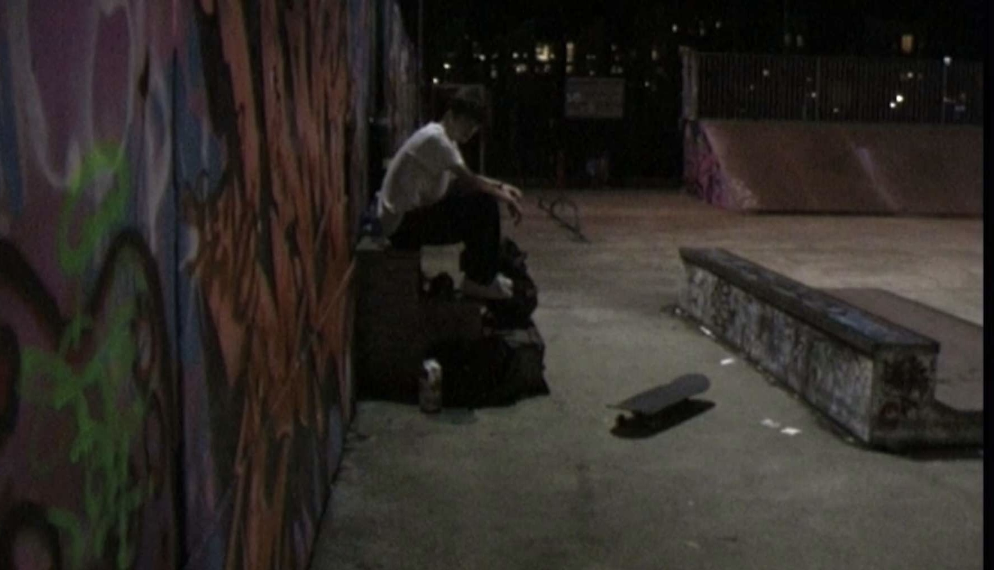
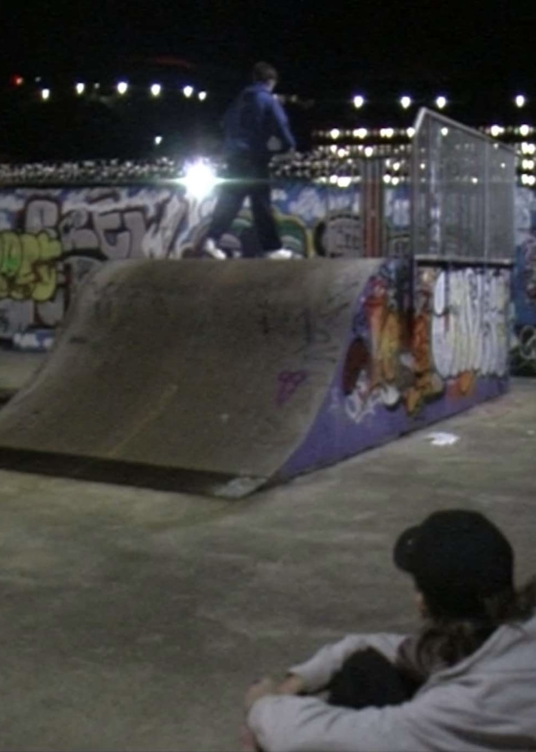
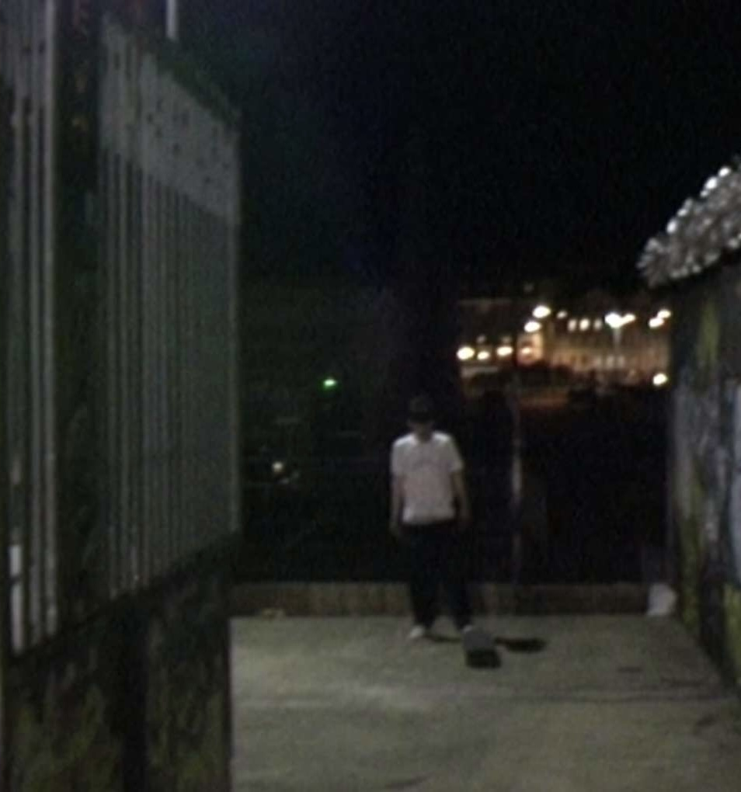
My Photos

Slide 6
Photo #1
My thought process when capturing this image was focused on the dull vs light areas of the photo. The skatepark where the boy is standing is very dull, providing effects of darkness and leaving the mind to wander, whereas the lights behind the boy signify life, proving there are many different lives going on all around us and that us ourselves are only the main focus of our own world rather than the actual world its self.

Slide 7
Photo #2
My main-focus within taking this photo was the idea of how we are all conscious of others around us, like were all closely looking into other people's lives, which leaves the question in the air of why we do this. Are we just interested, or do we always feel some sort of jealousy when looking at other people? Within this image you can see one boy observing another at a sport which they both love, almost proving that this look can only have two meanings, one being a look of jealousy, and the second almost being a feeling of proudness. It leaves to the imagination that you never truly know what is going through someone's mind while they look at you even if you think that you do know the full story. This photo is so minimalistic with not much to see through the naked eye but somehow it still manages to express so many feelings.

Slide 8
Photo #3
Within this photo you can clearly see the different textures of the floor and the ramps, when looking at them you can grab a sense that they are metal and cold, leaving an eerie feeling . This feeling really makes the colours on the wall more vibrant as if they are almost popping out of the wall leaving the rest of the image to be cold and dark. This image portrays the depth of the skate park and how different areas of it are perceived in different ways by different minds, one area may look easier to do and more fun whereas another may look challenging and worrying.

