Slide 1
Personal Study
Planner & Tracking
LOVE & REBELLION
A-Level Photography
Coursework Unit 2
10 Weeks
Deadline: Thurs 11 Feb 2021
MVT 2020

Slide 2
A-Level Coursework
The A-level coursework consist of two modules, Personal Investigation (worth 72 marks) and Personal Study (essay worth 18 marks) which are interlinked and informed by each other
All the work that you produced (both coursework and exam) in Yr 12 also contributes towards A-Level coursework and overall equate to 60% of the total marks. The Personal Study essay account for 12%. The last week before H-Term 8-10 Feb is a Mock Exam and will count as final DEADLINE.
On Thursday 11 Feb we will handout Exam paper and begin work on the final component, Externally Set Assignment (Exam) that accounts for the remaining 40% of the combined A-level Photography marks

Slide 3
What is a Personal Study?
The aim of this unit is to critically investigate, question and challenge a particular style, area or work by artists/ photographer(s) which will inform and develop your own emerging practice as a student of photography. The unit is designed to be an extension of your practical work in your Personal Investigation module where the practical informs and develops the theoretical elements and vice versa of your ongoing project.
Your Personal Study is a written and illustrated dissertation, including a written essay (2000 words) and a lens-based body of work (either stills photography or moving image) with a number of final outcomes produced from your Personal Investigation unit.
This year you have a choice to make either a film (3-5mins) or a photo book, either online using Blurb or by hand using traditional book binding techniques, which you design to include both your essay and a final selection and sequence of your photographs produced as a response to your chosen theme(s) of LOVE & REBELLION.
In addition, you are expecting to produce an appropriate amount of blogposts that demonstrates your ability to research, analysis, plan, record, experiment, present and evaluate.

Slide 4
What it says in the syllabus (Edexcel)
Essential that students build on their prior knowledge and experience
developed during the course.
Select artists work, methods and art movements appropriate to your previous
coursework work as a suitable basis for your study.
Investigate a wide range of work and sources.
Develop your written dissertation in the light of your chosen focus from the
practical part of previous coursework and projects.
Establish coherent and sustainable links between your own practical work
with that of historical and contemporary reference.
Be aware of some of the methods employed by critics and historians within
the history of art and photography.
Demonstrate a sound understanding of your chosen area of study with
appropriate use of critical vocabulary.
Show evidence for an ongoing critical and analytical review of your
investigation – both your written essay and own practical work in response to
research and analysis.
Develop a personal and critical enquiry.
Culminate in an illustrated written presentation.

Slide 5
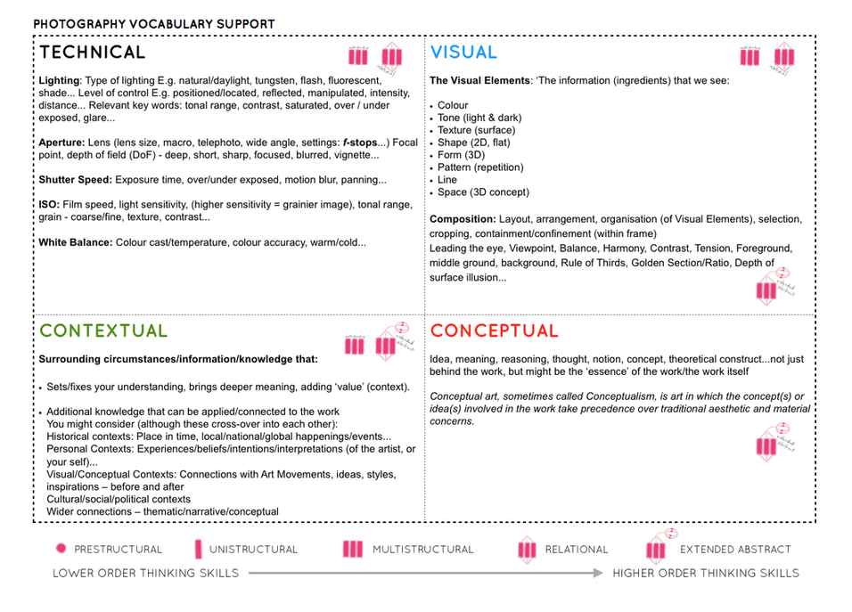

Slide 6
Quotation and
Harvard System of Referencing
Use quotes to support or disprove your argument
Use quotes to show evidence of reading
Take notes when you’re reading…key words, concepts, passages etc.
Write down page number, author, year, title, publisher, place of publication so you can list source in a bibliography
Use Harvard System of Referencing…see Powerpoint: Harvard System of Referencing for further details.
For further help of how to construct your essay – see Powerpoint: Personal Study + Essay structure

Slide 7
Week 12: 23 – 29 Nov Introduction to Personal Study Review and Reflect | Slides to improve: Actions to take | Complete by:
Objective: Criteria from the Syllabus Essential that students build on their prior knowledge and experience developed during the course. Develop your written dissertation in the light of your chosen focus from the practical part of previous coursework and projects. How to get started: Link your chosen area of study to your previous work, knowledge and understanding based upon your chosen theme(s) of LOVE & REBELLION
From your Personal Investigation based on LOVE & REBELLION write an overview of what you learned and how you intend to develop your Personal Study. Describe which themes, medium (photography, film), approaches (documentary, tableaux, conceptual), artists, skills and photographic processes/ techniques inspired you the most and why. Include examples of current experiments to illustrate your thinking. Produce a new mind-map and mood-board based around how you interpret the theme of LOVE & REBELLION now using new inspirations etc. Write a specification that clearly contexualises how you wish to develop your project further, including exploring theme(s), interpreting subject-matter, constructing a narrative and producing a final outcome (photobook/ film). Plan your first photo-shoot as a response to initial ideas. Must be published on the blog by Wed 2 Dec.

Slide 8
Tracking sheet
Week 13: 30 Nov – 6 Dec Theory & Practice: Artists References Contextual Studies: Conversations on Photography | Slides to improve: Actions to take | Complete by:
ARTISTS REFERENCES: Select 2-3 artists/photographers that have inspired your work already and that you would like to research in depth as a basis for your Personal Study. Compare and contrast their practice and work following these steps: Produce a mood board with a selection of images and write an overview of their work, style, approach and subject matter. Select at least one image from each photographer and analyse in depth using methodology of TECHNICAL > VISUAL > CONTEXTUAL > CONCEPTUAL. Incorporate quotes and comments from artist themselves or others (art critics, art historians, curators, writers, journalists etc) using a variety of sources such as Youtube, online articles, reviews, books Make sure you reference sources and embed links to the above sources in your blog post.
MEANING & METHODS: Identify meaning and methods behind selected artists/photographers work and research at least 3 different literary sources (online articles, books, Youtube clips) that will provide you with different critical perspective and views other than your own.
CONTEXTUAL STUDY: Conversations on Photography Read interview, identity 3 quotes and apply theory to an image
PLANNING: Plan a shoot in response to researching and interpreting artists work above. Make sure it relates to your ideas on how you intend to develop your project. Follow these instructions: what, why, how, when, where? RECORDING: Complete planned photo-shoot and bring images in to class. Begin to edit and show experimentation with images using Lightroom / Photoshops/ Premiere as appropriate to your intentions. Make sure you annotate processes and techniques used. EVALUATION: Upon completion of photoshoot and experimentation, make sure you evaluate and reflect on your next step of development.

Slide 9
Tracking sheet
Week 14: 7 – 13 Dec Theory & Practice: Art Movements & Isms | Slides to improve: Actions to take | Complete by:
THEORY > Art Movements & Isms For this task you need to select an art movement and ism that is relevant to your Personal Study : Pictorialism / Tableaux Realism / Straight Photography / Documentary Modernism Post-modernism Follow these instructions: Start by looking at the PPT presentations here which will provide you with an overview. M:\Departments\Photography\Students\Resources\Personal Study. Find two other sources, article on internet, text in book, Youtube video etc and identify relevant quotes, at least two that you can incorporate into your blog post/ presentation. Use Art Movements & Isms sheet as a prompt with information that is required in your presentation. Write 500 words which would form the basis of paragraph 1 in your essay and publish on blog. Your presentation must include visual examples of artists making work within that art movement and ism. Prepare a 2-3 mins presentation at the end of the week Fri 11 Dec.
PRACTICE> Photographic responses Respond to the art movement/ ism that you have researched and make an image or a set of images that represent the methods/ techniques/ processes/ approach/ styles / aesthetics used by artists working within that is ism or movement. Make it relevant to your own project. Produce a blog post and publish by – Mon 13 Dec

Slide 10
Tracking sheet
Week 15 + Xmas: 14 Dec – 4 Jan Essay introduction: Academic study skills Contextual Study: Decoding Photography | Slides to improve: Actions to take | Complete by:
Academic Sources Research and identify 3-5 literary sources from a variety of media such as books, journal/magazines, internet, Youtube/video . Begin to read essay, texts and interviews with your chosen artists as well as commentary from critics, historians and others. It’s important that you show evidence of reading and draw upon different pints of view – not only your own. Take notes when you’re reading…key words, concepts, passages Write down page number, author, year, title, publisher, place of publication so you can list source in a bibliography Bibliography: List all the sources that you use
Quotation and Referencing: Use quotes to support or disprove your argument Use quotes to show evidence of reading Use Harvard System of Referencing…see Powerpoint
Essay Question Think of a hypothesis and list possible essay questions Here is a list of possible questions to investigate that may help you.
Essay Plan Make a plan that lists what you are going to write about in each paragraph – essay structure.
Essay introduction Write a 45 mins draft in lesson
Contextual Studies: Decoding Photography Select one of the questions listed Read text in detail, make notes and identify 3 quotes Select one image from examples mentioned in text and apply your own interpretation of the photograph by applying theory and critical thinking Incorporate the 3 quotes above into your interpretation of the image and make sure you comment on the quotes.

Slide 11
Tracking sheet
Week 16: 4 – 10 Jan Practical work: PHOTOBOOK Photo-shoots & Experimentation | Slides to improve: Actions to take | Complete by:
PLANNING: PHOTOBOOK Narrative: What is your story: 3 words, a sentence, a paragraph. How will you tell your story: images, archives, texts Recording: Produce a detailed plan of at least 3-4 photoshoots that you intend on doing in the next 4 weeks – including Christmas break. Presentation: must present one shoot, with editing/ experimentation in class
PRACTICAL WORK: PHOTOBOOK Produce a number of photographic response to your Personal Study and bring images from new photo-shoots to lessons: Save shoots in folder on Media Drive: and import into Lightroom Organisation: Create a new Collection from each new shoot inside Collection Set: LOVE & REBELLION Editing: select 8-12 images from each shoot. Experimenting: Adjust images in Develop, both as Colour and B&W images appropriate to your intentions Export images as JPGS (1000 pixels) and save in a folder: BLOG Create a Blogpost with edited images and an evaluation; explaining what you focused on in each shoot and how you intend to develop your next shoot. Make references to artists references, previous shoots, experiments,
FURTHER EXPERIMENTATION: Export same set of images from Lightroom as JPEG (4000 pixels) Experimentation: demonstrate further creativity using Photoshop to make composite/ montage/ typology/ grids/ diptych/triptych, text/ typology etc appropriate to your intentions Design: Begin to explore different layout options using Indesign and make a new zine/book. Set up new document as A5 page sizes. This is trying out ideas before we begin designing photobook in January. Make sure you annotate process and techniques used

Slide 12
Tracking sheet
Week 16: 4 – 10 Jan Practical work: FILM Photo-shoots & Experimentation | Slides to improve: Actions to take | Complete by:
PLANNING: FILM Narrative: What is your story: 3 words, a sentence, a paragraph. How will you tell your story: visuals, sound, archives (incl found imagery) Storyboard: Based on your specification and narrative produce a storyboard with details of individual scenes, action, shot sizes, camera angles and mise-en-scene (the arrangement of the scenery in front of the camera) from location, props, people, lighting, sound etc. Recording: Produce a detailed plan of at least 3-4 video/audio recordings that you intend on doing in the next 4 weeks, incl Christmas break Presentation: must present one shoot, with editing/ experimentation in class
PRACTICAL WORK: FILM Produce a number of photographic response to your Personal Study and bring footage from video/ audio recordings to lessons: Save media in folder on local V:Data Drive Organisation: Create a new project in Premiere Editing: begin editing video/ audio clips on the timeline Adjusting: recordings in Colour / B&W appropriate to your intentions. Experimenting: with sequencing using relevant transitions and effects Sound: consider how audio can add depth to your film, such as ambient sound, sound fx, voice-over, interview, musical score etc. Title and credits: Consider typography/ graphics/ styles etc. For more creative possibilities make title page in Photoshop (format: 1280 x 720 pixels) and import as a Psd file into your project folder on the V-Data drive. Export film as mp4 file and uploads to Youtube account and embed on Blog.
FURTHER EXPERIMENTATION: Write an evaluation on the blog that reflects on your artistic intentions, film-editing process and collaboration. Include screen-prints from Premiere and a few ‘behind the scenes’ images of the shooting/ production for further annotation.

