Slide 1
LOVE & REBELLION
ART & ACTIVISM
PLANNER
Autumn Term
Tracking & Monitoring
Photography A-level
Hautlieu School
2020-2021

Slide 3
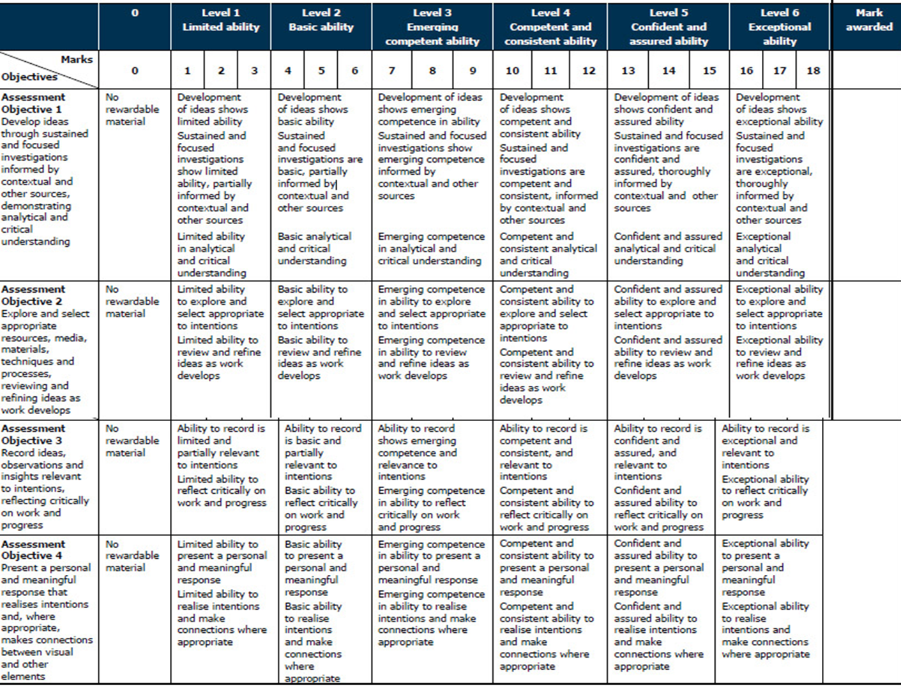

Slide 4
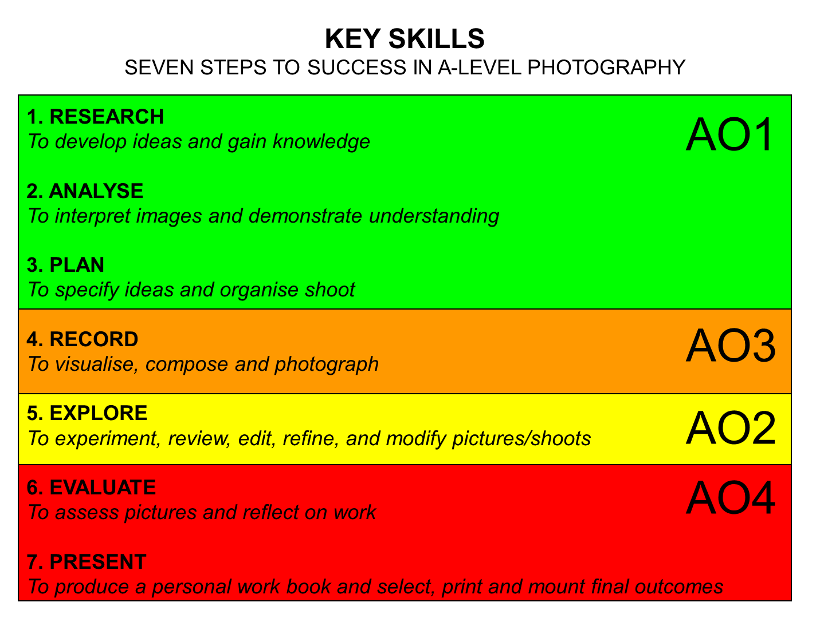

Slide 5
TRACKING SHEET: LOVE & REBELLION
Week 7: 12 – 18 Oct INSPIRATIONS & INFLUENCES RESEARCH > ANALYSIS Complete the following blog posts | Blog posts to improve/ Actions to take | Assessment Objectives Self-evaluate Award marks
THEORY & CONTEXT: Write 300-500 words expressing your view on identity politics and culture wars. How does it impact society? Describe some of the positive aspects on groups harnessing their shared identity and political views as well some of the dangers of tribalism dividing communities. Provide examples both for and against, reference sources used and include images. Try and frame the debate both within a global and local perspective. |  | AO1
PROTESTS & MOVEMENTS: Research political activism of the Suffragettes as well as the artistic movement of Dadaism. Describe each of their political ideologies and analyse what role photography played and how it was used as a propaganda tool. Make references to contemporary activism and movements, such as FEMEN, #meToo, BLM etc. |  | AO1
ARTISTS REFERENCES: A comparative study between Claude Cahun and a contemporary photographer. Analyse, describe and discuss similarities and/or differences between key examples of their work on political activism and gender identities. Follow these steps: Produce a mood board with a selection of images and write an overview of their work, style and approach to self-portraiture. Select at least one image and/or video from each artists and analyse in depth using methodology of TECHNICAL>VISUAL>CONTEXTUAL>CONCEPTUAL Incorporate quotes and comments from the artists themselves or others (art critics, art historians, curators, writers, journalists etc) using a variety of sources such as Youtube, online articles, reviews, text, books. Make sure you reference sources and embed links to the above sources in your blog post. Plan a photographic response that links with your 90 SEC FILM ASSIGNMENT |  | AO1

Slide 6
TRACKING SHEET: LOVE & REBELLION
Week 8: 19 – 25 Oct PLANNING & SPECIFICATION Complete the following blog posts | Blog posts to improve/ Actions to take | Assessment Objectives Self-evaluate Award marks
PLANNING > PITCHING 90 SEC FILM: A moving-image response in relation to the theme of REBELLION engaging with politics that are based on art, identity or culture. In groups of 2/3 students present idea and concept for your 90 sec film as a poster and manifesto. You have 30 mins to put together your poster and will have 30 seconds to present and pitch your idea to the class. Use Photoshop to design your poster and publish on the blog as a JPEG. Photo-game: You must use 3 words from ‘throwing the dice’ and incorporate into your manifesto and use those concepts as creative starting points for making your film. You must choose one rule to break and use creatively in the making of your film |  | AO1, AO3, AO4
SPECIFICATION > STORYBOARD Develop the above poster into a specification and produce a storyboard that provides you with a clear plan ahead of how you wish to make your 90 sec film, incl. mise-en-scene (the arrangement of the scenery in front of the camera) from location, props, people, lighting, sound etc. |  | AO2
ESSAY > WRITING In what way can the work of Claude Cahun and Shannon O’Donnell be considered political? Put in context of identity politics and both historical activism and contemporary movements. As exemplar, choose one key image of Cahun and O’Donnell for comparison. Read: two key text on gender identity / feminism/ self portraiture and incorporate relevant quotes and reference sources in your essay. DEADLINE: Wed 4 Nov. This is an independent study/ Homework task! |  | AO1, AO3, AO4

Slide 7
TRACKING SHEET: LOVE & REBELLION
Week 9-10: 26 Oct – 11 Nov (incl H-TERM) RECORDING > EDITING Complete the following blog posts | Blog posts to improve/ Actions to take | Assessment Objectives Self-evaluate Award marks
RECORDING > H-TERM Plan and complete principal shoot following your storyboard during h-term. Make sure you take a few images behind the scenes of the production and are using the right equipment; camera, sound recorder, tripod etc. |  | AO2, AO3
EDITING > FILM PRODUCTION Still-images: Edit and adjust using Lightroom and export as high-res jpgs ready for import into Premiere Moving-images & Sound: Upload clips into Premier and edit on the timeline. Show experimentation with cuts/ transitions/ duration etc. Title and credits: Consider typography/ graphics/ styles etc. Export film as mp4 file and uploads to Youtube account and embed on Blog Deadline: Mon 9 Nov |  | AO3
EVALUATING > SCREENING Write an evaluation on the blog that reflects on you artistic intentions, film-editing process and collaborating as a group. Include screen-prints from Premiere and a few ‘behind the scenes’ images of the shooting/ production. Screening Wed 11 Nov: Prepare a short presentation of your film with Q&A. |  | AO4

