Slide 1
Personal Study
Planner & Tracking
Occupation vs Liberation
A-Level Photography
Coursework Unit 2
12 Weeks – Spring Term
Deadline: MOCK EXAM 10-14 FEB 2020
MVT 2019

Slide 2
A-Level Coursework
The A-level coursework consist of two modules, Personal Investigation (worth 72 marks) and Personal Study (essay worth 18 marks) which are interlinked and informed by each other
All the work that you produced (both coursework and exam) in Yr 12 also contributes towards A-Level coursework and overall equate to 60% of the total marks. The Personal Study essay account for 12%. The last week before H-Term 10-12 Feb is a Mock Exam and will count as final DEADLINE.
On Thursday 13 Feb we will handout Exam paper and begin work on the final component, Externally Set Assignment (Exam) that accounts for the remaining 40% of the combined A-level Photography marks

Slide 3
What is a Personal Study?
The aim of this unit is to critically investigate, question and challenge a particular style, area or work by artists/ photographer(s) which will inform and develop your own emerging practice as a student of photography. The unit is designed to be an extension of your practical work in your Personal Investigation module where the practical informs and develops the theoretical elements and vice versa of your ongoing project.
Your Personal Study is a written and illustrated dissertation, including a written essay (2000 words) and a photographic body of work (250- 500 photos) with a number of final outcomes produced from your Personal Investigation unit.
This year you have to make a photo book, either online using Blurb or by hand using traditional book binding techniques, which you design to include both your essay and a final selection and sequence of your photographs produced as a response to your chosen theme(s) of OCCUPATION vs LIBERATION.
In addition, we are also expecting that those of you who want to go above and beyond to achieve top grades will produce a mini film/ pod cast with sound and images based on the same narrative as above

Slide 4
What it says in the syllabus (Edexcel)
Essential that students build on their prior knowledge and experience
developed during the course.
Select artists work, methods and art movements appropriate to your previous
coursework work as a suitable basis for your study.
Investigate a wide range of work and sources.
Develop your written dissertation in the light of your chosen focus from the
practical part of previous coursework and projects.
Establish coherent and sustainable links between your own practical work
with that of historical and contemporary reference.
Be aware of some of the methods employed by critics and historians within
the history of art and photography.
Demonstrate a sound understanding of your chosen area of study with
appropriate use of critical vocabulary.
Show evidence for an ongoing critical and analytical review of your
investigation – both your written essay and own practical work in response to
research and analysis.
Develop a personal and critical enquiry.
Culminate in an illustrated written presentation.

Slide 5
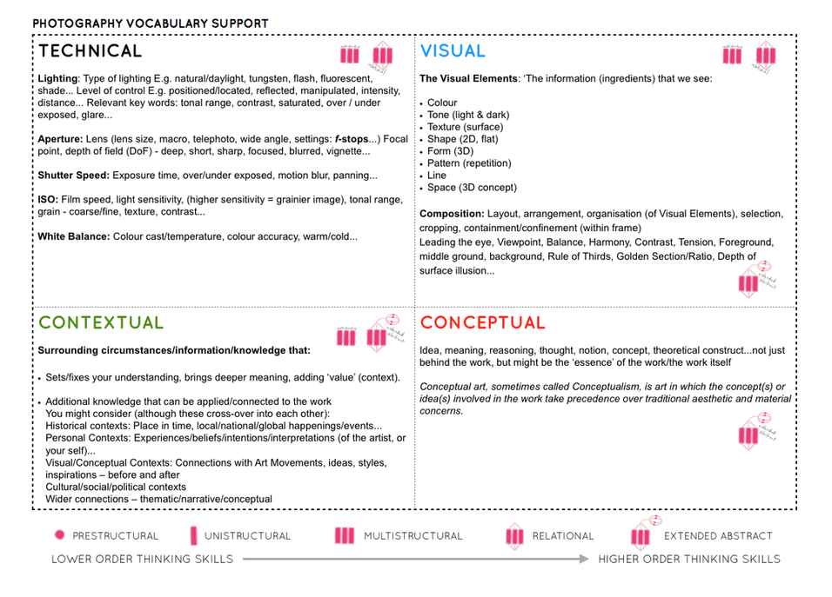

Slide 6
Quotation and
Harvard System of Referencing
Use quotes to support or disprove your argument
Use quotes to show evidence of reading
Take notes when you’re reading…key words, concepts, passages etc.
Write down page number, author, year, title, publisher, place of publication so you can list source in a bibliography
Use Harvard System of Referencing…see Powerpoint: Harvard System of Referencing for further details.
For further help of how to construct your essay – see Powerpoint: Personal Study + Essay structure

Slide 7
Planner 6 weeks – PHOTOBOOK & ESSAY
WK 16: 7 – 13 Jan
Research:
Analysis:
Planning:
Recording:
Experimenting:
Evaluating:
Presenting:
DEADLINE All photo-shoots 13 Jan
WK 17: 13 – 20 Jan
Research:
Analysis:
Planning:
Recording:
Experimenting:
Evaluating:
Presenting:
DEADLINE Photobook research
WK 18: 20 – 27 Jan
Research:
Analysis:
Planning:
Recording:
Experimenting:
Evaluating:
Presenting:
WK 19 : 27 Jan – 3 Feb
Research:
Analysis:
Planning:
Recording:
Experimenting:
Evaluating:
Presenting:
DEADLINE Draft Essay 31 Jan
WK 20: 3 – 10 Feb
Research:
Analysis:
Planning:
Recording:
Experimenting:
Evaluating:
Presenting:
DEADLINE : Draft layout 7 Feb
WK 21 : 10 – 14 Feb Mock Exam
Research:
Analysis:
Planning:
Recording:
Experimenting:
Evaluating:
Presenting:
DEADLINE: Last day of your Mock Exam
WK 22: 15 – 23 Feb H-TERM Research:
Analysis:
Planning:
Recording:
Experimenting:
Evaluating:
Presenting:
READ Exam Paper and find inspirations
WK 23: 24 Feb – 2 March
Research:
Analysis:
Planning:
Recording:
Experimenting:
Evaluating:
Presenting:
EXAM PREP: Develop Ideas

Slide 8
TRACKING SHEET: SPRING TERM - DEADLINE MOCK EXAM 10-14 FEB
Sections to complete Week 16: 6 – 13 Jan Editing images and write Essay paragraph 1 | Slides to improve: Actions to take | Complete by:
PHOTOBOOK: Lesson time (Mon, Tue, Thurs & Fri) Bring images from new photo-shoots to lessons and follow these instructions Save shoots in folder and import into Lightroom Organisation: Create a new Collection from each new shoot inside Collection Set: PHOTOBOOK Editing: select 8-12 images from each shoot. Experimenting: Adjust images in Develop, both as Colour and B&W images appropriate to your intentions Export images as JPGS (1000 pixels) and save in a folder: BLOG Create a Blogpost with edited images and an evaluation; explaining what you focused on in each shoot and how you intend to develop your next photoshoot. Make references to artists references, previous work, experiments, inspiration etc. Prep for photobook design: Make a rough selection of your 40-50 best pictures from all shoots. Make sure you have adjusted and standardised all the pictures in terms of exposure, colour balance.
Further experimentation: Export same set of images from Lightroom as TIFF (4000 pixels) Experimentation: demonstrate further creativity using Photoshop to make composite/ montage/ typology/ grids/ diptych/triptych, text/ typology etc appropriate to your intentions Design: Begin to explore different layout options using Indesign and make a new zine/book. Set up new document as A5 page sizes. This is trying out ideas before you begin designing photobook. Make sure you annotate process and techniques used and evaluate each experiment
Essay: Lesson time (Wed) Complete Paragraph 1 and upload to the blog no later than WED 15 Jan.

Slide 9
TRACKING SHEET: SPRING TERM - DEADLINE MOCK EXAM 10-14 FEB
Sections to complete Week 17: 13 - 20 Jan: Research / deconstruct photo book | Slides to improve: Actions to take | Complete by:
Photobook: Lesson time (Mon, Tue, Thurs & Fri) READ these texts to better understand how to identify a narrative and understand the design process of photobook making. Colin Pantall: Identifying the Story: Sequencing isn't narrative Extension: Here are a serious blog post by Photobook critic, Joerg Colberg which consider the many aspects of photobook making: The Forms an Functions of Photobooks
Research a photo-book and describe what story/narrative the book is telling - its subject-matter, genre, style, approach etc.
Who is the photographer? Why did he/she make it? (intentions/ reasons) Who is it for? (audience) How was it received? (any press, awards, legacy etc.)
Deconstruct the narrative, concept and design of the book such as: Book in hand (how does it feel?0, paper and ink, format, size and orientation, design and layout, rhythm and sequencing, structure and architecture, narrative. title, images and text
Write a book specification and describe in detail what your book will be about in terms of narrative, concept and design. Produce a mood-board of design ideas.
Narrative: What is your story? Describe in: 3 words, a sentence, a paragraphs
Essay: Lesson time (Wed) Complete Paragraph 2 and upload to the blog no later than WED 22 Jan.

Slide 10
TRACKING SHEET: SPRING TERM - DEADLINE MOCK EXAM 10-14 FEB
Sections to complete Week 18- 19-20 -21: 18 Jan – 14 Feb MOCK EXAM 3 days (15 hrs) Mon 10 – Fri 14 Feb Design your Photobook & Complete Essay | Slides to improve: Actions to take | Complete by:
Photobook: Lesson time (Mon, Tue, Thurs & Fri) Using Lightroom make a rough selection of your 40-50 best pictures from all shoots. Make sure you have adjusted and standardised all the pictures in terms of exposure, colour balance/ B&W, contrast/brightness etc.
Decide on format (landscape, portrait) size and style of your photo-book. Begin to design your photo book, considering carefully, narrative, sequencing, page spreads, juxtaposition, image size, text pages, empty pages, use of archival material etc.
At the end of your photo book, add your illustrated essay including title, any captions (if needed), bibliography, illustrations of artists work (incl data) and images of your own responses. Think carefully about font type, size and weighting.
Produce screen prints of layout ideas as you progress and add to Blog for further annotation, commenting on page layout/ narrative/ sequencing/ juxtaposition of pictures.
Select a set of 5-6 photographs as final outcomes and evaluate – explaining in some detail how well you realised your intentions and reflect on what you learned in your Personal Study. Save final outcomes in our PRINT folder by 15:00 end of your Mock exam in a high-resolution (4000 pixels on the long edge.)
Make sure all blog posts are finished including, research, analysis, experimentation, annotation and an evaluation of final outcomes. DEADLINE: END OF YOUR LAST DAY OF MOCK EXAM
Essay: Lesson time (Wed) Complete conclusion, bibliography, proof read and hand in draft essay. no later than Fri 31 Jan.

