Slide 1
PLANNER
Tracking & Monitoring
Summer Term
BUNKER ARCHAEOLOGY
Autumn Term
OCCUPATION vs LIBERATION
Photography A-level
Hautlieu School
2019-2020

Slide 3
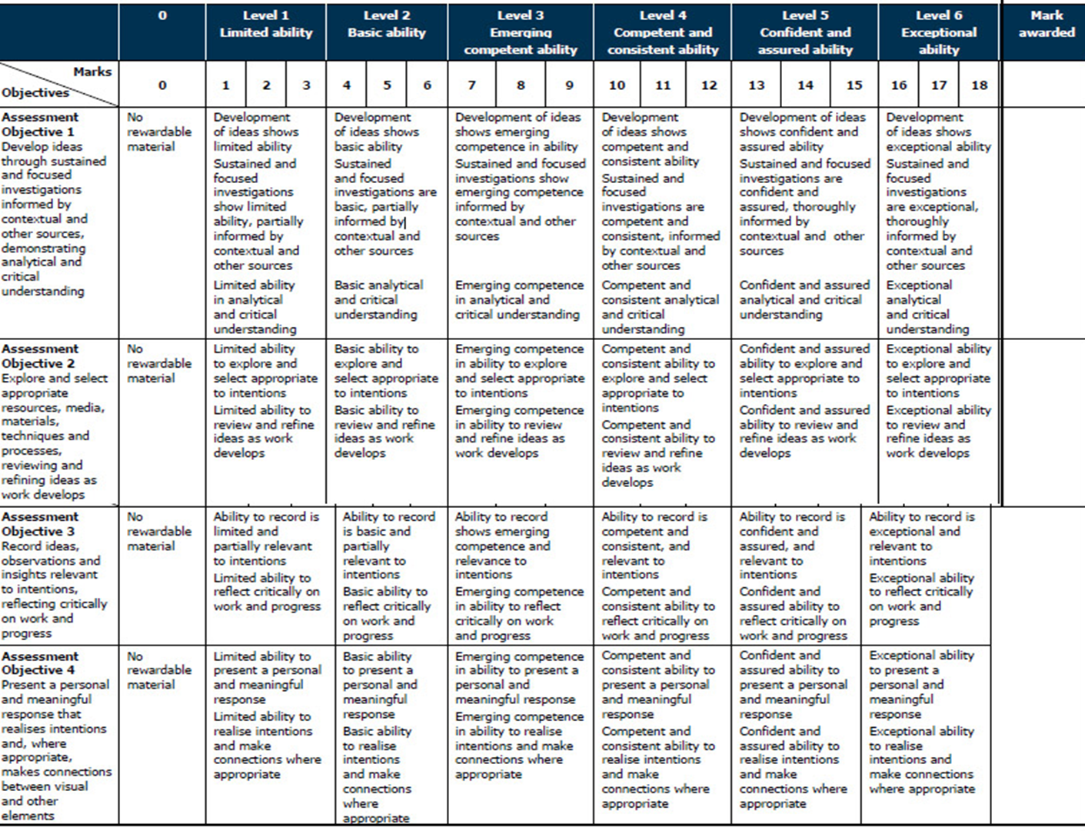

Slide 4
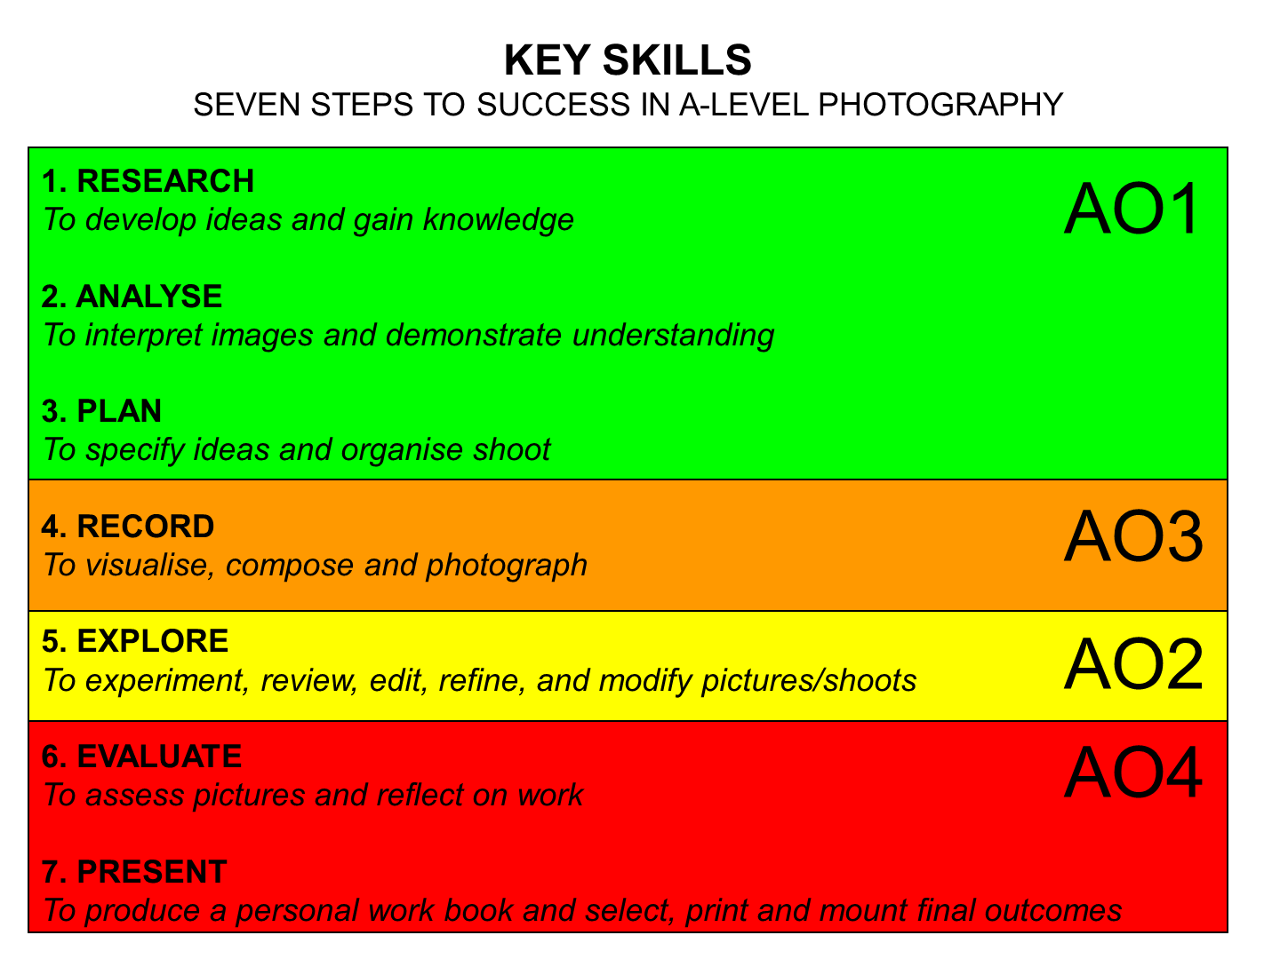

Slide 5
TRACKING SHEET: SUMMER TERM
Week 1: 4 -9 June Research Photo-Archives Complete the following blog posts | Blog posts to improve/ Actions to take | Assessment Objectives Self-evaluate Award marks
RESEARCH > ANALYSIS Research archives at Societe Jersiaise Use mobile phone to record images from collections Write 500 words about your knowledge and understanding of German Occupation of Jersey |  | AO1
ARTISTS REFERENCES > VISUAL INSPIRATIONS Select 10 images from your research in photo archives and note SJPA reference numbers and photographer (if known) High-res files will be provided for further study in the classroom If photographer is known research online. Otherwise research and consider the image in the context of when it was made, WWII, Nazi oppression, political unrest, human sufferings etc. Select at least one contemporary photographer that provides visual inspiration for your own shoots. Follow these steps: Produce a mood board with a selection of images and write an overview of photographer’s work, why you have chosen them and how it may help develop your own ideas and shoots for your project. Select at least one image from each photographer and analyse in depth using methodology of TECHNICAL>VISUAL>CONTEXTUAL>CONCEPTUAL Make a detailed shooting plan on how you intend to respond to your research and chosen photographers. | find out Research the Photo-Archive and select at least one collection of images/ photographers from the list provided | AO1
Extension task: Select a second photographer from the Photo-Archive and /or second contemporary photographer and follow the above instructions. Deadline: Monday 10^{h} June

Slide 6
Week 1-2: 5 – 19 June Contextual Studies: Essay HOMEWORK Complete the following blog posts | Blog posts to improve/ Actions to take | Assessment Objectives Self-evaluate Award marks
CONTEXTUAL STUDIES > ESSAY WRITING Write a 1000 word essay and answer this question: Whose Archive is it Anyway? To answer this question you need to reflect on Photo-Archive talk on Tue 4 June at the Société Jersiaise when we began the Bunker Archaeology project. Here is a link to Intro to the Photo Archive Research at least two photographers from the list below in the photo-archive and choose one photograph from each that illustrates the themes of Occupation or Liberation and include it in your essay Read also the text by theorist David Bate: archives-networks-and-narratives_low-res, make notes and reference it by incorporating quotes into your essay to widen different perspectives. Comment on quotes used to construct an argument that either support or disapprove your own point of view. Watch the Youtube clips below and consider the following sub-questions
INDEPENDENT STUDY > HOMEWORK - Choose at least one option Explore public archives and find links to your research and project based around Political Landscapes. Make a blog post Explore your own family/ personal archives over and make a blog post with some of the material and describe how it will inform and develop your Personal Investigation. Ask parents, grand-parents and other family members to look through photo-albums, letters, boxes etc.
DEADLINE: Essay – Wed 19 June DEADLINE: Independent Study – Tue 3 Sept (after Summer Hols)

Slide 7
TRACKING SHEET: SUMMER TERM
Week 2: 10– 16 June Photo-shoots: Bunkers and fortifications Complete the following blog posts | Blog posts to improve/ Actions to take | Assessment Objectives Self-evaluate Award marks
PLANNING > RECORDING PHOTO-SHOOT 1: Mon 10 / Tues 11th June On location shoot at Les Landes Provide a detailed plan for your shoot at Les Landes. What do you want to focus on? How do you want your images to look and feel like? Include visual references to artists/photographers in terms of style, approach, intentions, aesthetics, subject-matter, concept and outcome. Editing: Upload and process images from photo-shoot using Adobe Lightroom and make a rough edit of 25-30 images Experimentation: Experiment with your edited images adjusting colour/ B&W/ cropping/ collaging / composite / incorporate archival images/ ephemera / found material etc. Evaluation: Evaluate your photo-shoot and consider how you can develop your ideas/ concept for the second shoot.
PHOTO-SHOOT 2, 3, 4: You must research and visit area of study in Jersey and produce a second shoot with a sense of purpose and direction. You have a choice to make images in the evening when it is dark or during daytime. NB! Make sure you consider times of day, lighting/ weather. Eg. If you are photographing in a busy area and you want no people or traffic you have to shoot early in the morning / late evening and PLAN according to weather conditions too Deadline: Monday 8th July

Slide 8
TRACKING SHEET: SUMMER TERM
Week 3: 17 -23 June Editing: Introduction to Lightroom Complete the following blog posts | Blog posts to improve/ Actions to take | Assessment Objectives Self-evaluate Award marks
EDITING > LIGHTROOM - Import images from folder on M:drive into Lightroom - Create Collection Set: Bunker Archaeology - Create Collection: Bunker Shoot 1 under the above Collection Set - 1st Edit using selection tools such as Pick (P) and Reject (X) – 100-50 image - 2nd Edit using 3-5 stars rating – 50-60 images - 3rd Edit using Colours, Yellow and Green for a final 20-30 images - Use Compare and Survey View for selecting best images - Produce print screens from each stage of editing and produce a blog post with annotation
DEVELOPING > LIGHTROOM Basic adjustment in COLOUR using White Balance / Exposure / Levels / Brightness /Contrasts / Highlights /Whites/ Blacks Advanced adjustment: Cropping/ Spot Removal/ Graduate Filter / Adjustment Brush/ Lens Correction/ Transform / Vignetting Export to EDIT folder: Set of colour images in high-res as tiffs (4000 pixels on long edge) for further experimentation in Photoshop Export to BLOG folder: same set of colour images as above in low-res jpgs (1000 pixels) to upload to blog post with annotation REPEAT same procedure as above in BLACK & WHITE and export both a set of high-res (4000 pix) and low-res (1000 pix)
EXPERIMENT 1: CROPPING > LIGHTROOM In Photoshop open up high-res tiff files Using cropping tool only begin to make some radical changes by selecting areas of your images for a different visual impact. Produce at least 3 different crops for 6 images.
EXPERIMENT 2: COLOUR > B&W ADJUSTMENTS > LIGHTROOM Use tools such as White Balance / Exposure / Levels / Curves / Brightness /Contrasts / Colour Balance / Hue / Saturation / Colour overlay and make radical changes to the overall aesthetic of the images. Try and adjust images according to your visceral quality – relating to your deep inward feelings rather than how something looks! Produce 3 different adjustments with images

Slide 9
TRACKING SHEET: SUMMER TERM
Week 4: 24- 30 June Experimenting: Photo-montage Complete the following blog posts | Blog posts to improve/ Actions to take Narrative and Sequencing | Assessment Objectives Self-evaluate Award marks
RESEARCH > ANALYSIS inspirations for photo-montage
EXPERIMENT: MONTAGE > COMPOSITE IMAGES Using your skills in Photoshop work with different techniques montage / collage / cut n past/ composite / Layers / Masks / Opacity / Blending modes / Brush techniques Use your selected images and produce at least 3 different collages combining two or more images / people / landscapes / text / typography / colour / shapes / textures/ Combine your images with images from the Photo-Archive that relate to your area of focus eg Battery Moltke. Go to the folder and choose at least 3 high-res images from selected photographers, Print out 1 of your own images and 1 archive images on the Laserjet and manipulate the prints by destroying it in 5 different ways and re-configure using scissors / tape / cut-n-paste / glue. Try and manipulate the printed images using your body / hand/ face too…you should become a part of the image.

Slide 10
TRACKING SHEET: SUMMER TERM
Week 5: 1 – 7 July Narrative and Sequencing Complete the following blog posts | Blog posts to improve/ Actions to take | Assessment Objectives Self-evaluate Award marks
RESEARCH > ANALYSIS Research zines and newspaper design made by artists and photographer that will provide visual stimulus for your page design. Produce a mood board and consider the following in your analysis: How you want your design to look and feel Format, size and orientation Design and layout Rhythm and sequencing Narrative and visual concept Images vs text Colour and B&W (or a mix)
EVALUATE > REFLECT Produce a blog post where you evaluate your first sequence of images, reflect on what story you are trying to communicate and how you can improve and develop your narrative. Edit 20-30 images down to an ordered series of 10-15 images Thinks about start, middle and end images Think about your theme or subject What happens or changes over the series of images? Are you using your best images?

Slide 11
TRACKING SHEET: SUMMER TERM
Week 6-7: 8 – 17 July Design and Layout: Intro to InDesign Complete the following blog posts | Blog posts to improve/ Actions to take | Assessment Objectives Self-evaluate Award marks
PRESENT > EVALUATE Select on a final sequence with a set of 10-15 images that express your own personal feelings towards the landscape of German fortifications. This set of images could be made entirely of your full frame, cropped, adjusted or montaged images or a combination. The important thing is that it is a coherent set of images which communicates a specific narrative and express visually your own unique view. Show evidence of your design process and different versions and possible outcomes with annotation. Complete 4 double page spreads and write final evaluation (250-500) that describe in detail what your page spreads are about in terms of narrative, concept and design. Consider the same criteria as above.
RE-VISIT AND RE-SHOOT Here are few things to consider for your third shoot Revisit location and make another shoot. Reflect on your current sequence of images and think about what is missing, or what you need to photograph to add value to the story you are trying to communicate. Collect ephemera / found objects and photograph them in-situ – how and where you found them and also re-photograph the objects as a still-life at home setting up your own mini-studio or use Photo-studio in school. Record sounds or video as another visual layer / audio ambience that you could incorporate into your project eg. select individual frames from video and edit as a sequence in a time line. Use audio on IPhone to record conversation with people you meet or use it as dictaphone to record your own feelings in a diary form. Complete by Wed 17 July

