Slide 1
BBC / PSB
https://www.bbc.co.uk/historyofthebbc/
Learning intentions: to understand:
The concept of PSB
The ideas of Jean Seaton, James Curran and Jurgen Habermas
Have some understanding of the history of the BBC
Have some understanding of the way in which the BBC is regulated

Slide 2
Dr M 3 things from BBC
I looked at timeline
1st broadcast was radio 192-23
General strike 1926
1953 Coronation of Queen Eliszabeth impact of TV (patterns of consumption)

Slide 3
WHAT ARE THE CRITERIA FOR SUCCESSFUL QUALITY TV and RADIO BROADCASTING?
BROADCASTING AND NARROWCASTING?

Slide 4
What institutions are producing TV?
The following media institutions are involved in producing the TV CSP’s, identify which are relevant to your case studies and start researching and gathering evidence about.
Size, scale, ethos and ownership
Can you link any of the concepts that we have looked at so far?
How and why have the produced the programme you have studied?
What quantitative data can you produce to support your ideas?
BBC Kudos AMC Networks SundanceTV RTL Television Channel 4 Walter Presents BBC4 | Dancing Ledge Productions Netflix Gaumont Television AbbottVision DR AMC

Slide 5
The concept of Public Service Broadcasting
The Transformation of the Public Sphere
PSB
‘ethos’

Slide 6
Jean Seaton – The concept of Public Service Broadcasting
What is PSB?
“a flexible means of managing and developing an important utility which has been commercially successful and also served the public“
“bringing public awareness the whole range of activity and expresssion developed in society” (Pilkington Report 1962)
The Future of broadcasting: “needs to find a new kind of commitment to public service“
Independence – ie keeping free from state control “without a commitment to public service, broadcasters are increasingly vulnerable to political interference”
Accountability – ie who looks after the BBC and makes sure it does what it is supposed to do: Annan Report 1980 “on balance the chain of accountability is adequate”
“threats posed by new technology” (Annan Report 1977)
“” the impact of unregulated competition for audiences, revenue and programmes
Choice – ‘real choice offered to consumers by a more effective market”
the allusion of Choice – “Choice, without positive direction is a myth, all too often the market will deliver more -but only more of the same”
Quality – the introduction of cable tv modified the principles of balance and quality (1982 Hunt Report)
CONCLUSION: “the pursuit of profit rather than excellence is more likely to dominate
James Curran – Power and Responsibility
“twin forces of creativity and business”
“profit driven motives take precedence”
As a consequence, prime time TV schedules dominated by light entertainment”
Why? Cheap, easy to make, recognisable format, popular, easy to consume
The concept of Public Service Broadcasting
Habermas – Transformation of the Public Sphere
the transformation of time and space,
the central place that the BBC plays in our everyday lives,
the link between individuals and celebrities, royalty, politicians etc,
the connection towards major events – Cup Finals, Coronations, abdications, funerals, economic unrest etc,
the way in which BBC acts as ‘social cement’

Slide 7
Can you link what you heard to key ideas?
PSB
‘ethos’
In the exam you are expected to be able to talk about the theories, concepts and ideas that we have studied (and are in the syllabus) with what you have seen / heard in the CSP
So . . . can you apply the ideas that Curran, Seaton and Habermas have of PSB on to the episode of Newsbeat that you have just listened to?

Slide 8
Use this structure to respond . . .
I listened to an episode of Newsbeat called . . . . . ., broadcast on . . . .
I think it links to . . . . . . Because at (time?) or when (name presenter / voice) when they are talking about . . . . It shows . . . . .
PSB
‘ethos’

Slide 9
Regulation
The BBC Charter is a https://www.bbc.com/aboutthebbc/governance/charter setting out the arrangements for the governance of the British Broadcasting Corporation.
Regulatory contexts: • Radio broadcasting is regulated by Ofcom • Regulation focuses on content including use of language, impartiality, protection of under 18s • PSB has very specific regulatory rules • Ofcom is also responsible for awarding -and rescinding – licenses which gives its regulation force • As radio has moved online and to podcasts, regulation has become more complex, in response the government launched a digital radio action plan and Ofcom produces a review each year • The availability of non-regulated broadcasts via the internet poses a challenge both for the regulator and the regulated radio broadcasters.

Slide 10
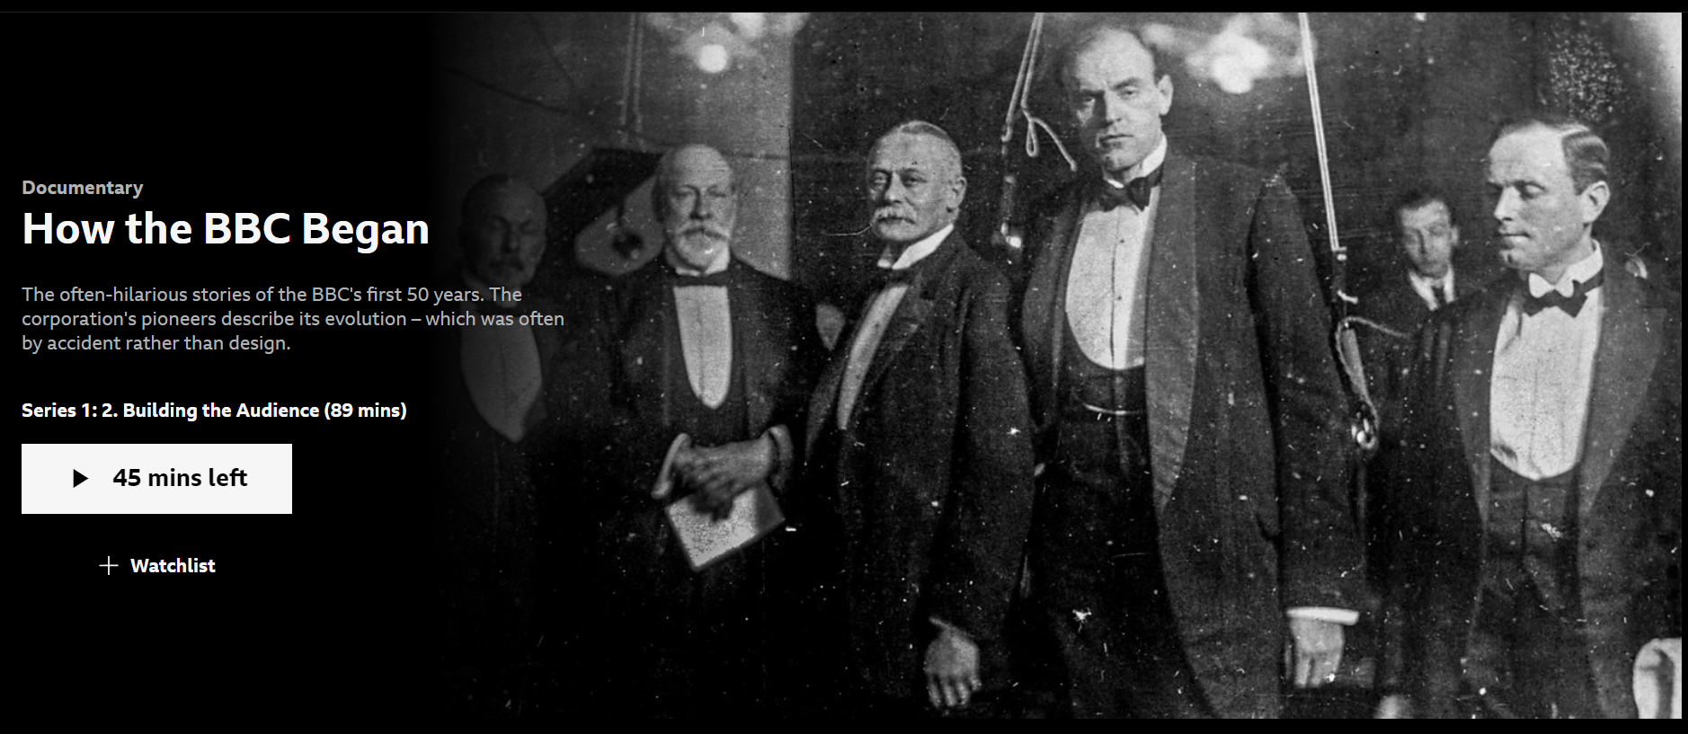
https://www.bbc.co.uk/iplayer/episodes/p0d5w8pf/how-the-bbc-began
Intro (50th anniversary) 00:00 – 2:25
BBC radio the start – “opening up new worlds to people” Cecil Lewis 2:25 – 6:41 – what does this mean?
It sounds like an ‘ethos’ – so what is the ethos of the BBC?
The argument of opening up ‘new worlds’ to everyday (= common? poor? working class? uneducated???) people could be applied to new media platforms – so what is the difference?
In many ways the BBC were looking at opening up (and sustaining) the Great Tradition – of progressive Western academic thought, stretching back from the birth of culture and civilization in Ancient Greece to the modern contemporary thinkers of today.
So how important do you think it is to sustain that tradition, even if it supports an elitist separation in society – those who know vs those who know nothing
PSB
‘ethos’
POPULISM vs PATERNALISM

Slide 11
Research, Reading and presentation
POPULISM v PATERNALISM
Look at the blog post
Look at the articles for further reading (which are on the blog post)
Use your own research
Use the revision book
Record your findings in your book
Record your findings on a PPT
Share your ppt with Dr M
Share your findings with the class using your PPT
PSB
‘ethos’
POPULISM vs PATERNALISM

Slide 12
Adorno is from The Frankfurt School it is a school of thought that helps us to think about the PURPOSE OF CULTURE. It also illustrates the distinction between POPULISM vs PATERNALISM – so should we give people what they want OR what is good for them?
POPULISM vs PATERNALISM
The Frankfurt School

Slide 13
Channel 4: PSB or Commerical?
Nicola Ross explores the importance of public service broadcasting and the impact that the privatisation of Channel 4 might have on British production companies and the content created in the UK.
Taken from Media Magazine 78, December 2021.

Slide 14
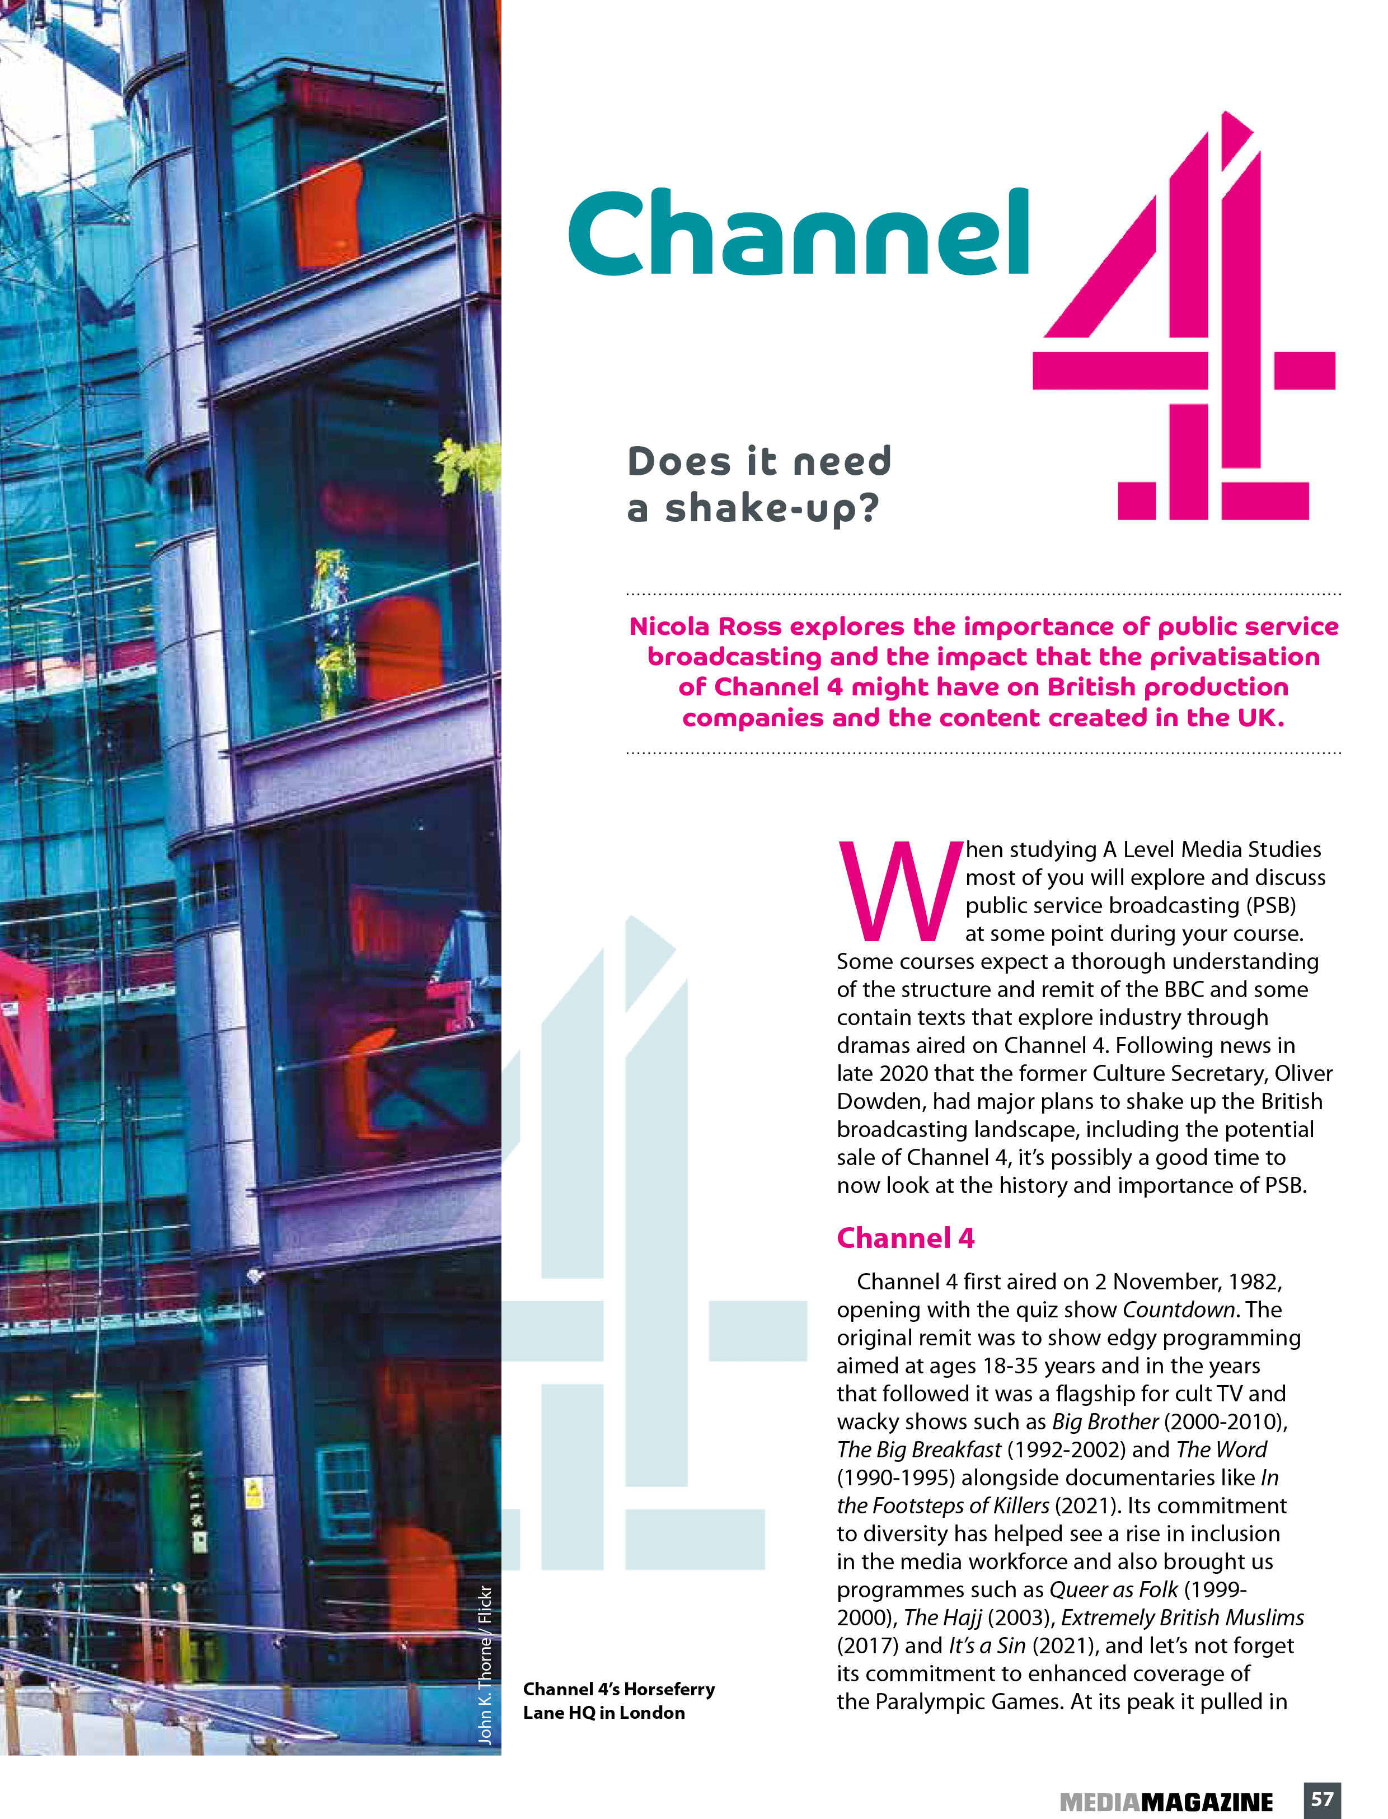
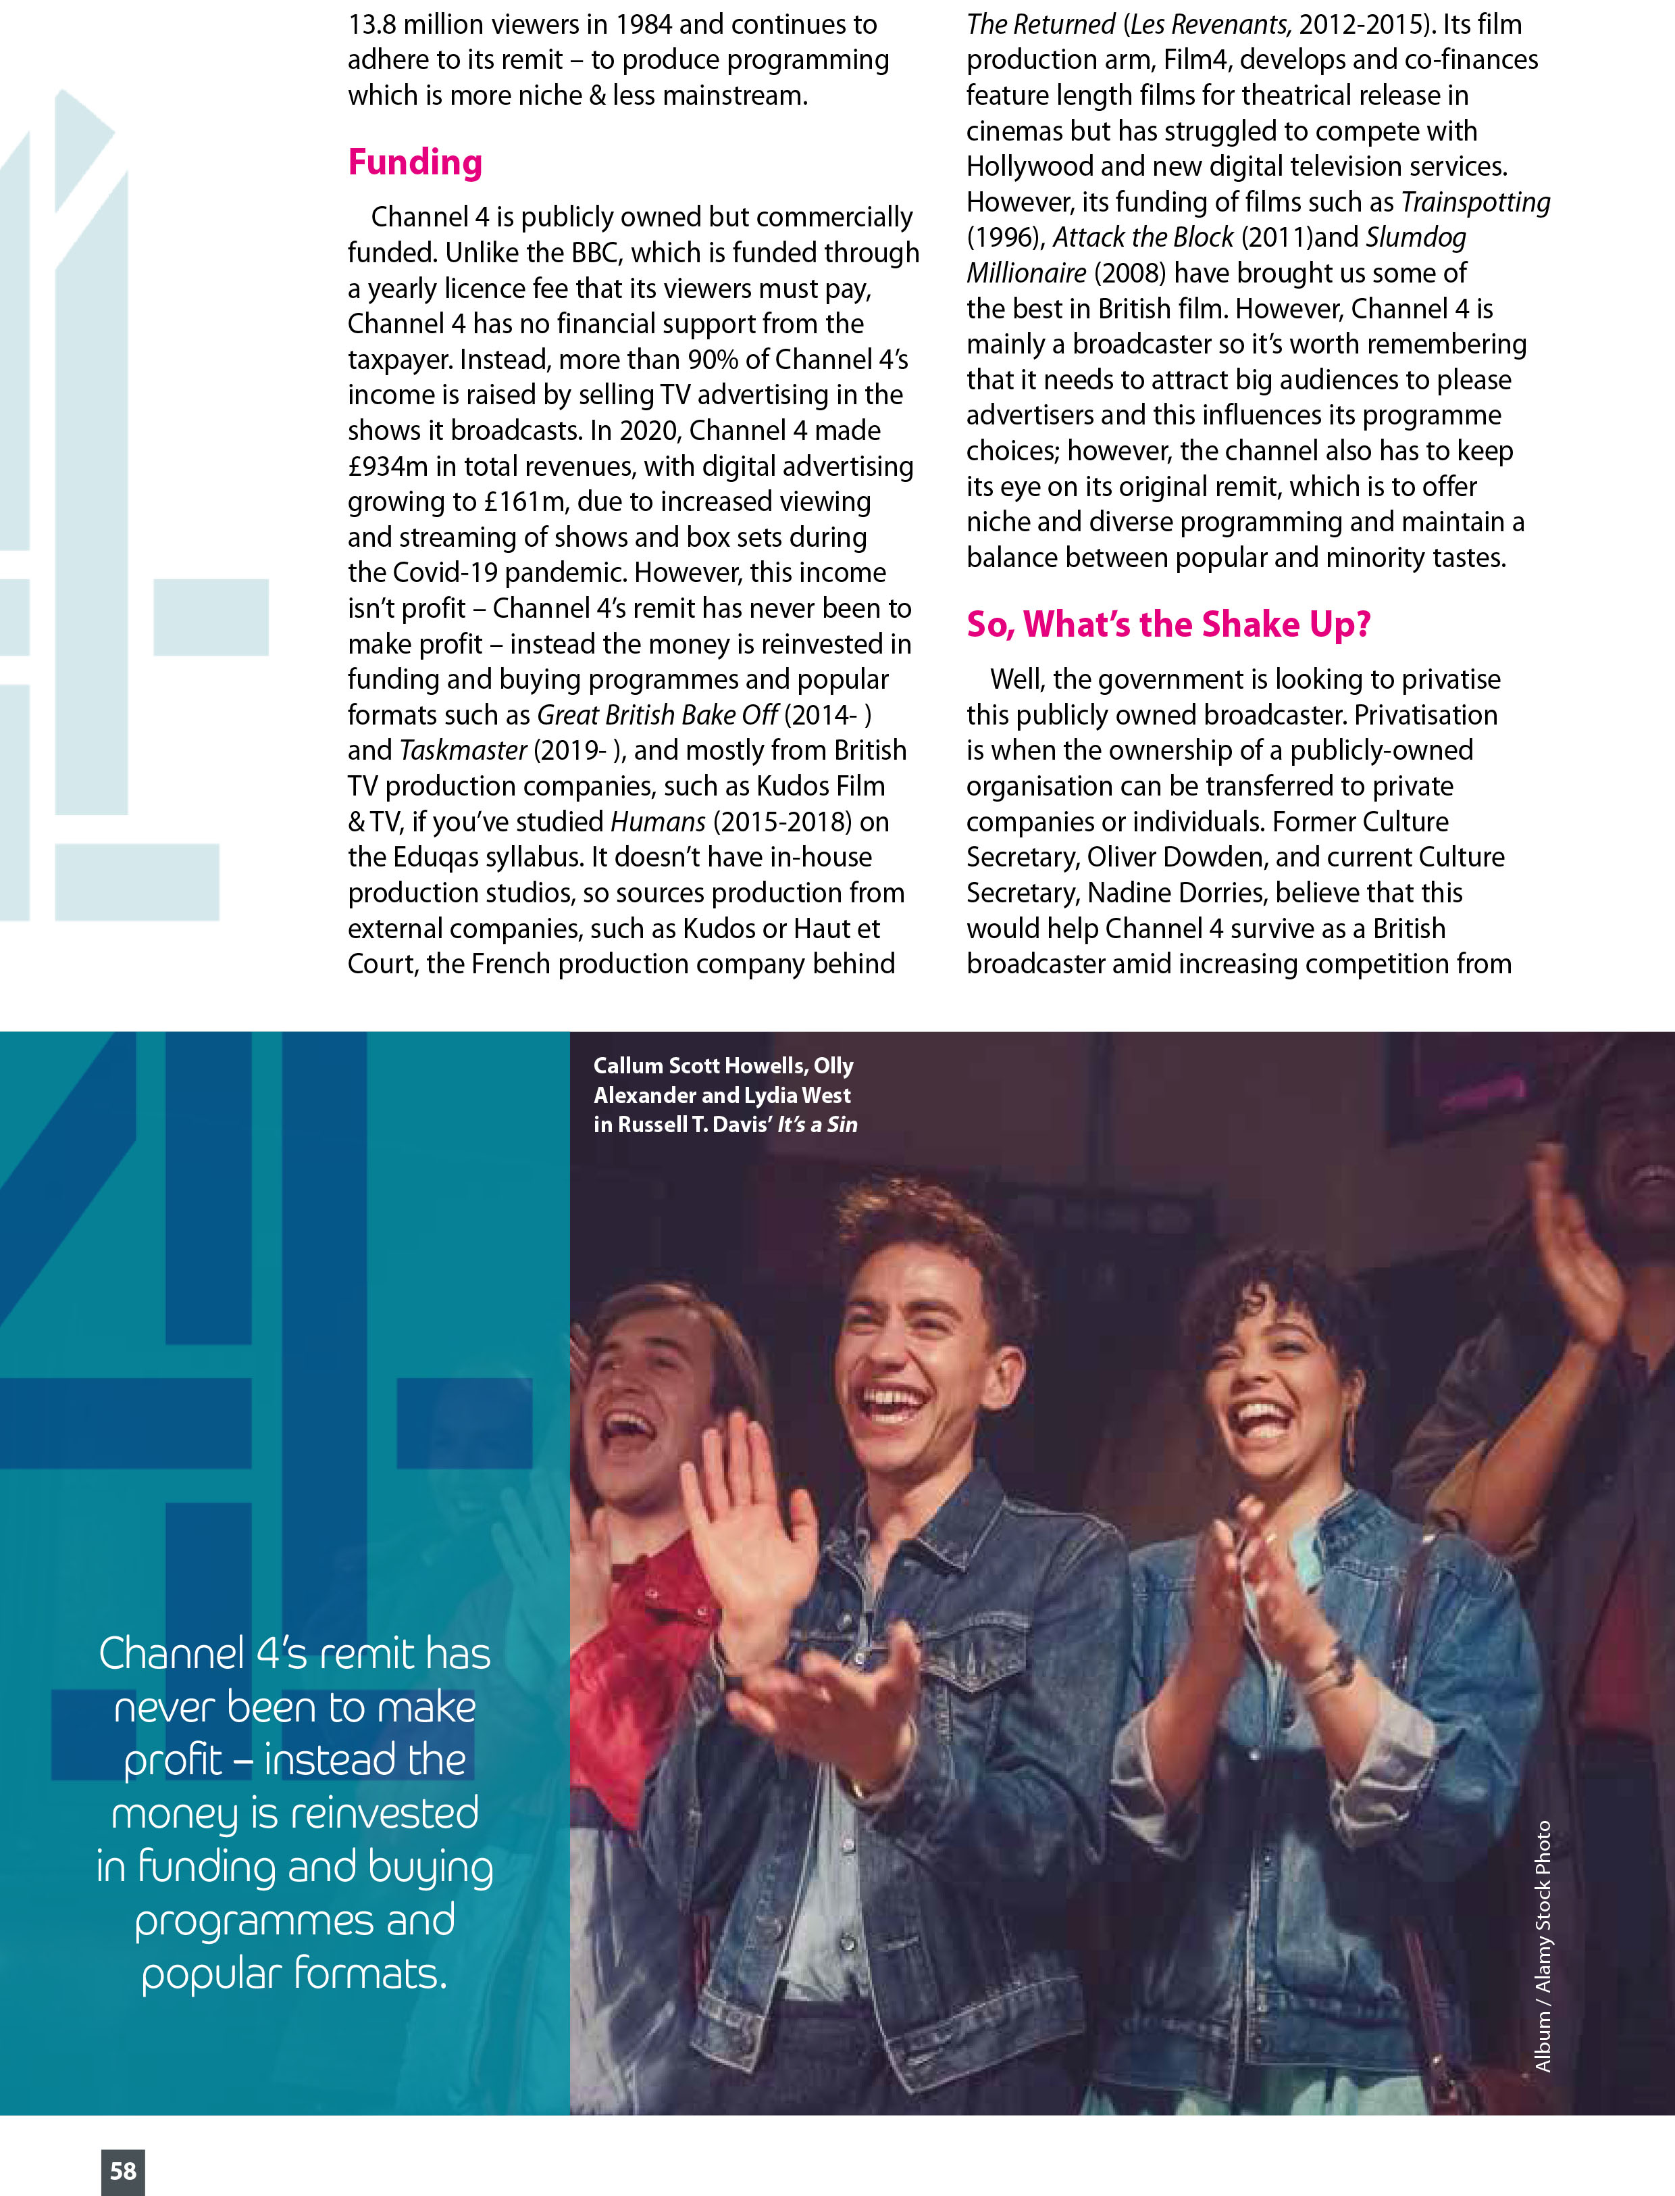

Slide 15
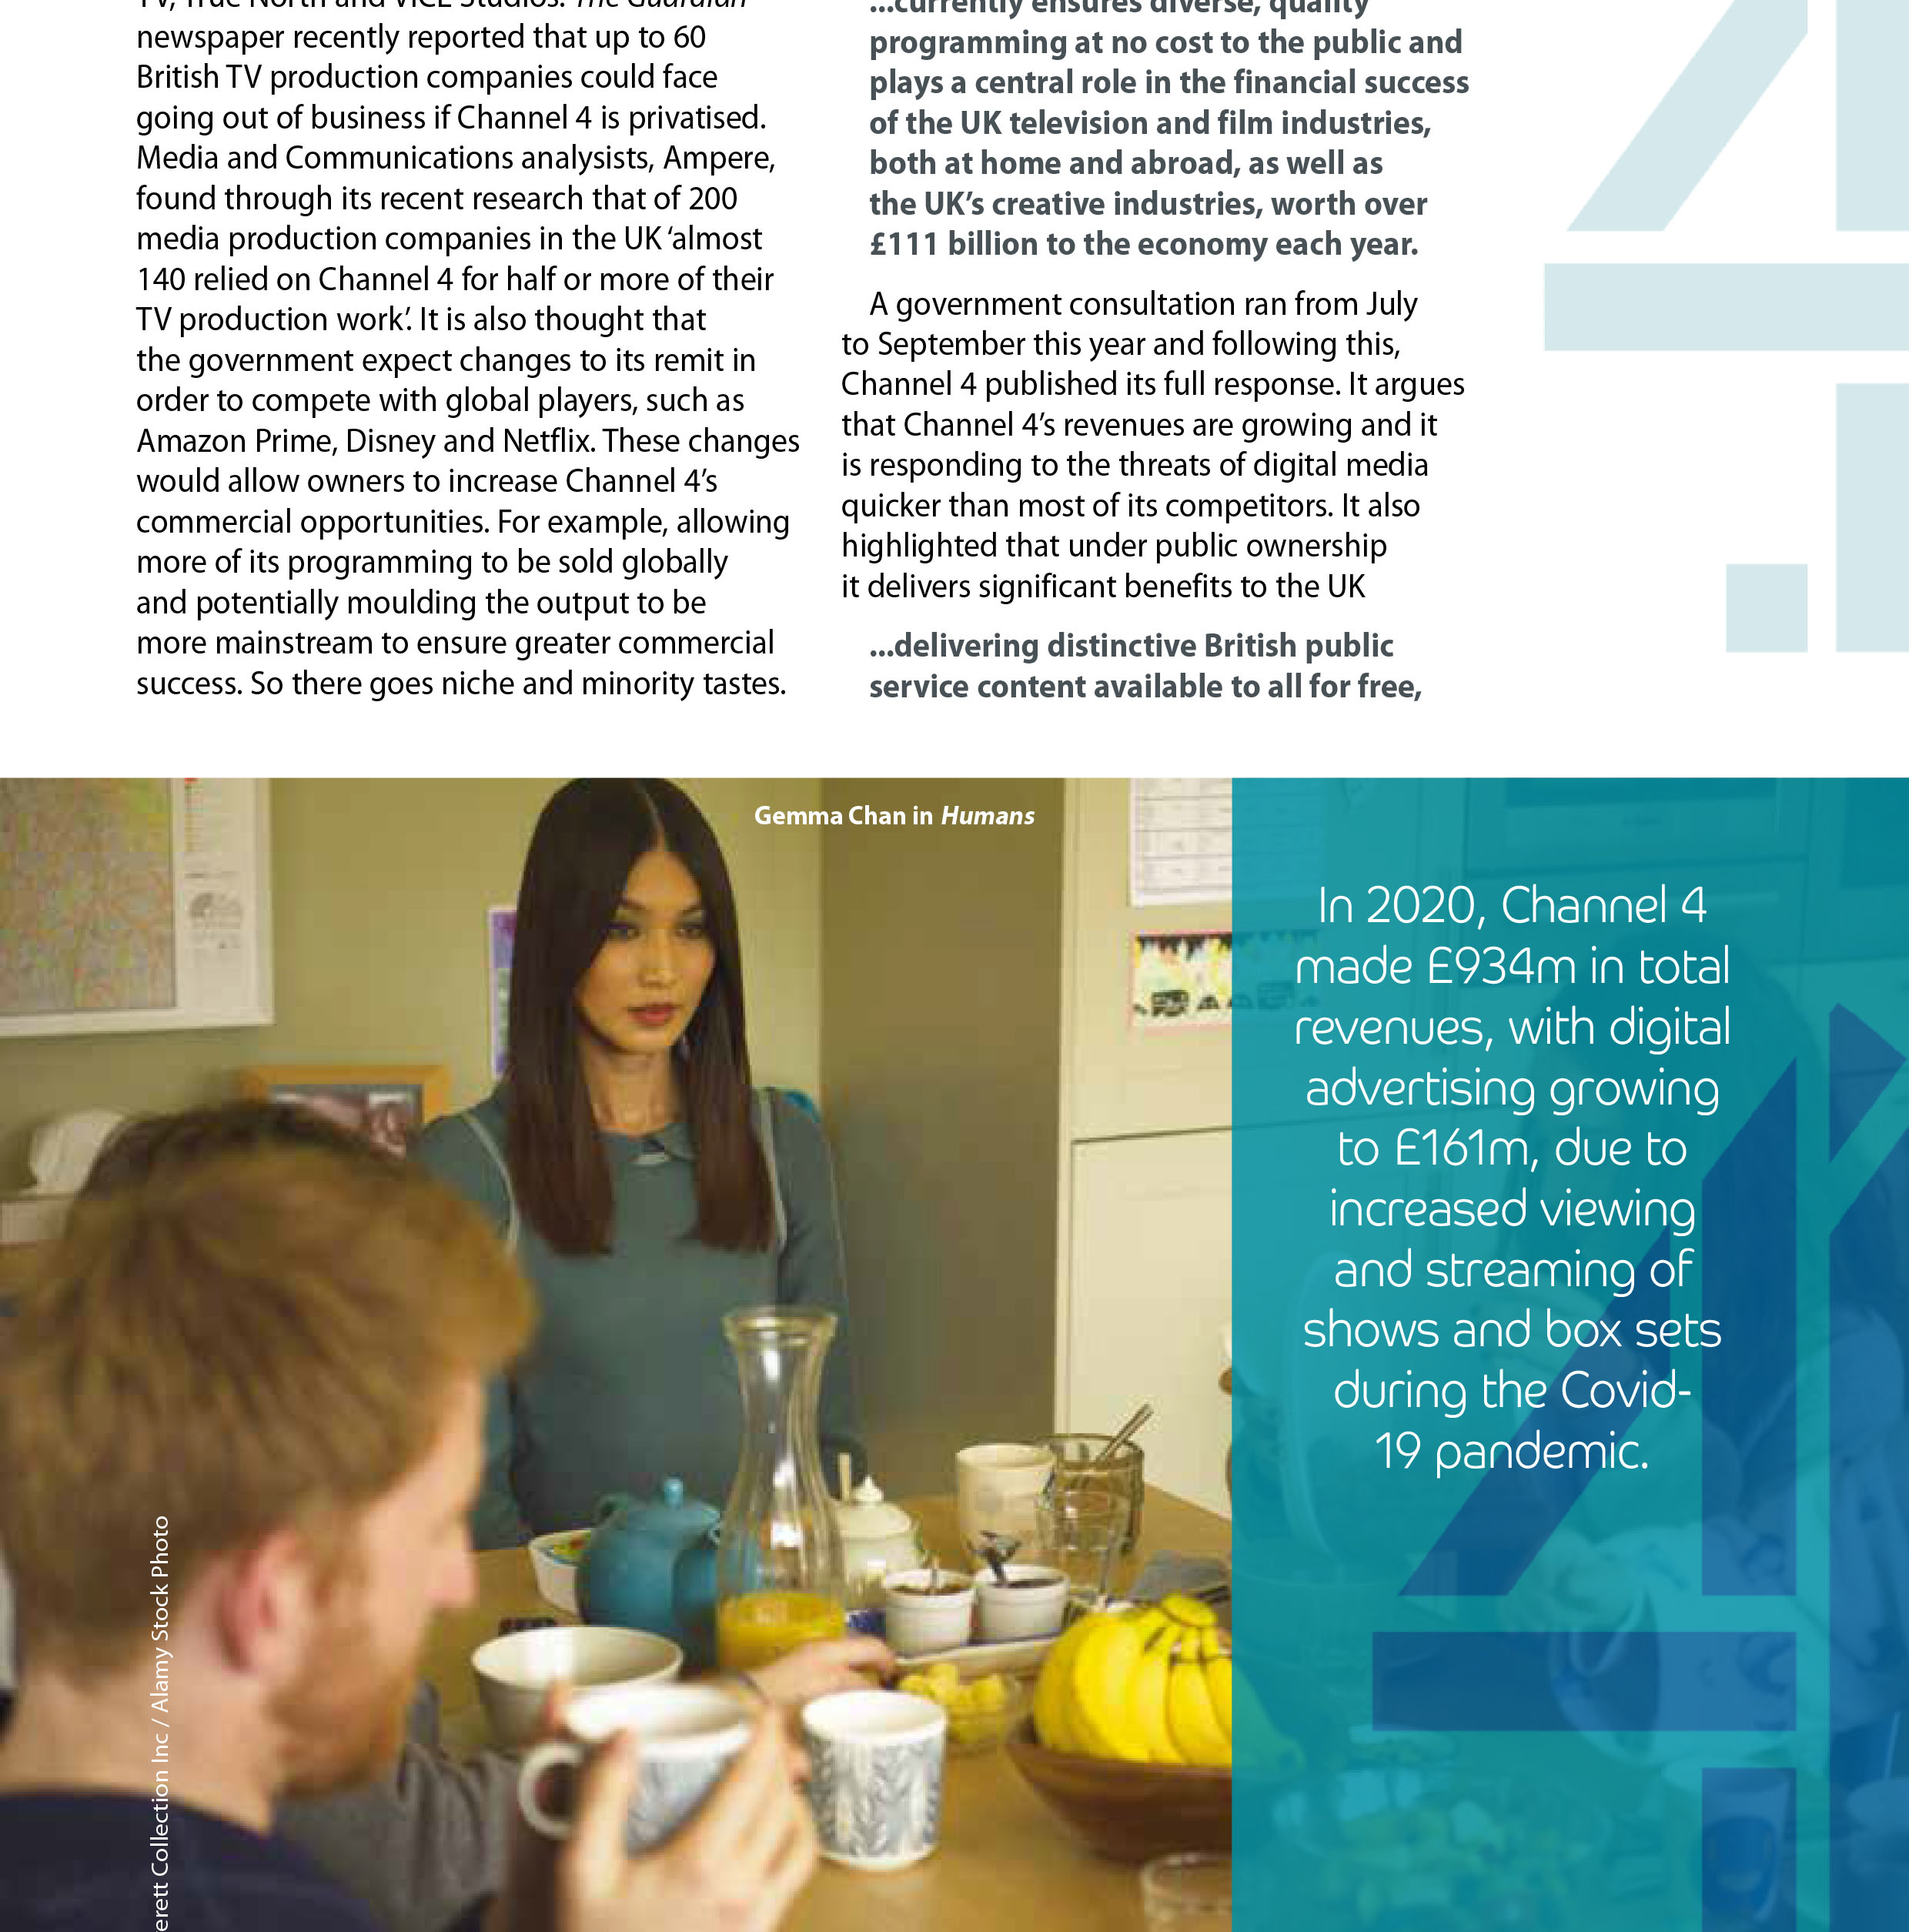

Slide 16
Summary
You need to understand:
The concept of PSB
The ideas of Jean Seaton, James Curran and Jurgen Habermas
Have some understanding of the history of the BBC
Have some understanding of the way in which the BBC is regulated

