Slide 1
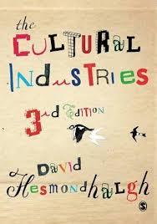
TV
Please try to read the following Chapters from your book:
12 Ownership Effects: James Curran and Jean Seaton
13 Regulation: Sonia Livingstone and Peter Lunt
14 The Culture Industry: David Hesmondhalgh
Approaches, Concepts and Ideas.

Slide 2
What is the purpose of the media?
Listen ~ Talk ~ Discuss ~ Respond ~ Make notes
The Media as a source of ‘USES AND GRATIFICATIONS’
A U D I E N C E T H E O R Y

Slide 3
Media Ownership
NAME AT LEAST ONE EXAMPLE FROM EACH TYPE OF OWNERSHIP IN TERMS OF TELEVISION
Public / State Owned
Private / Commercial
Community
WHAT ARE THE ADVANTAGES, BENEFITS AND DRAWBACKS OF EACH SYSTEM?

Slide 4
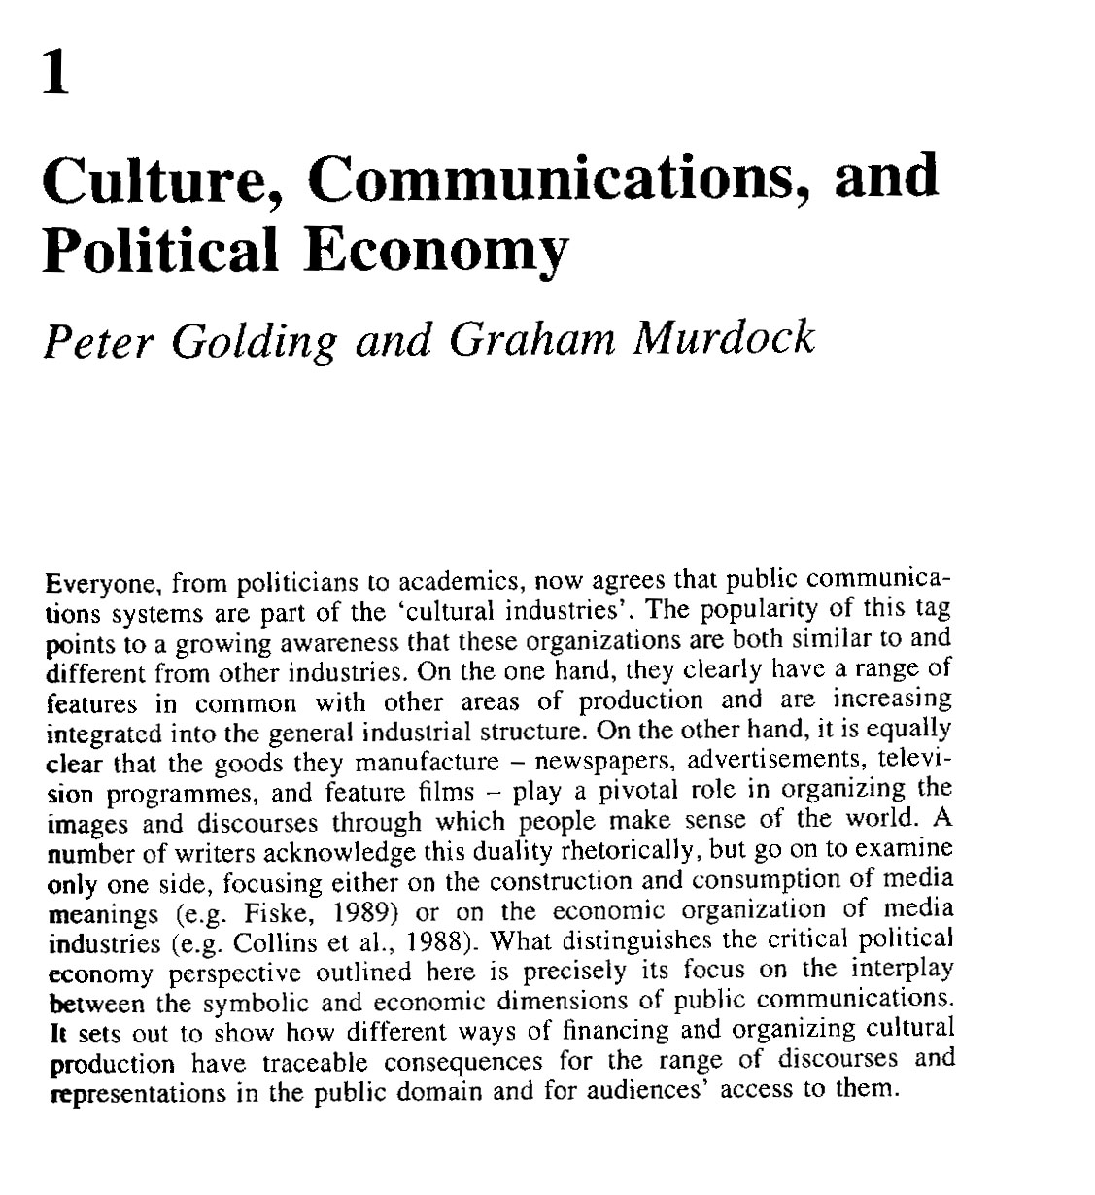
Why does ownership matter?
Q. Why are the ‘Cultural Industries’ are said to be different from other industries?
Put another way why should we be worried about who owns them?
Talk ~ Discuss ~ Respond ~ Make notes
Look at this recent story regarding plans to stop foreign ownership of newspapers:

Slide 5
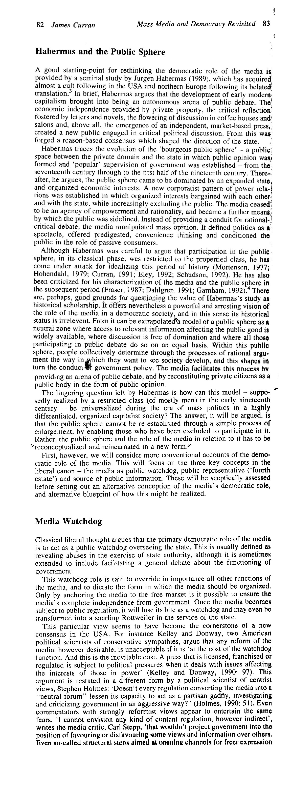
What is the purpose of the media?
Listen ~ Talk ~ Discuss ~ Respond ~ Make notes
Key Terms:
MEDIA WATCHDOG
PUBLIC SPHERE
4th ESTATE
The Media as a ‘Watchdog’ guarding the ‘Public Sphere’

Slide 6
Regulation and Control
How can television (and other media forms) be regulated?
What is the difference between a consumer-based media regulation system and a citizen-based regulation system?
Pages 141-2 of your book
What impact did the 2003 Communications Act have on media regulation?
Page 143 of your book
What is the drawback of a self-regulated system?
Page 144 of your book
How do you regulate media content and organisations on a global scale?

Slide 7
Business Practices
Follow the link below to look at recent mergers and acquisitions:
https://www.theguardian.com/business/mergers-and-acquisitions
Why?

Slide 8
Key Term | Definition | Key Term | Definition
Cultural industries Production Distribution Exhibition / Consumption Media concentration Conglomerates Globalisation Cultural imperialism Vertical Integration Horizontal Integration |  | Mergers Monopolies Gatekeepers Regulation Deregulation Free market Commodification Convergence Diversity Innovation

Slide 9
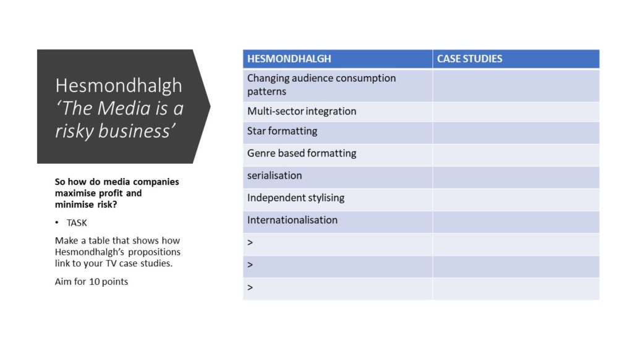
Look at Chapter 14: The Culture Industry: David Hesmondhalgh pp 153-164 to help you.

Slide 10
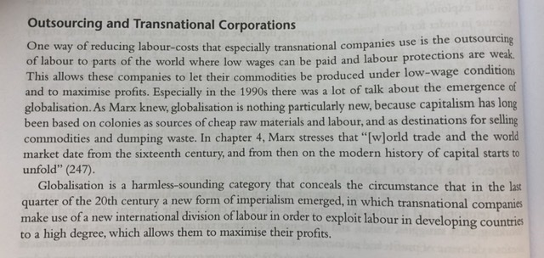
TRANSNATIONAL MEDIA CORPORATIONS: THE IMPACT OF GLOBALISATION
£$%
Read ~ Talk ~ Discuss ~ Respond ~ Make notes

Slide 11
Generic Conventions
Think about the way in which the TV programme you have watched is able to mitigate risk (Hesmondhalgh) by conforming to generic expectations. Think about:
Characters (Propp)
Themes (Levi-Strauss)
Structure (Todorov)
Did your programme present a set of predictable expectations along with some innovations?
This is the basis of genre theory (Steve Neale, chapter 4 of your book pp 39-49)
Re-visit ~ Re-cap ~ Re-read ~ Talk ~ Discuss ~ Respond ~ Make notes

Slide 12
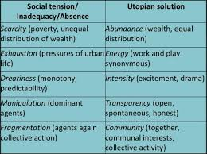
How does the Media provide enjoyment and escapism?
Listen ~ Talk ~ Discuss ~ Respond ~ Make notes
Richard Dyer’s Theory of Utopian Possibilities
TASK: Take each of the concepts presented by Dyer and show how your TV episode presents a solution.
Richard Dyer proposed the idea of ‘UTOPIAN POSSIBILITIES’
A U D I E N C E T H E O R Y

Slide 13
Ready to write an essay now?
From now on essays will not be open book

