Slide 1
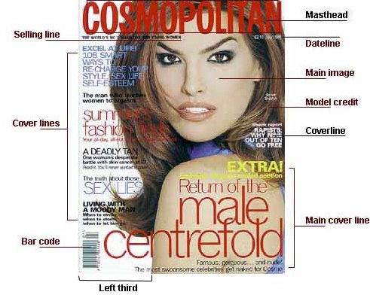
Magazines and Media Language
https://www.youtube.com/watch?v=peH6fBm0LD8&t=204s

Slide 2
LESSON AIMS
To know and understand how the different modes and language associated with magazines communicate multiple meanings and how the combination of elements of media language influence meaning.
To be able to analyse a magazine cover, contents page and article effectively by decoding their technical and semic codes.
To know and understand how to apply the media language terms mode of address, anchorage, relay, paradigm and syntagm.
To know and understand narrative theories with particular focus on key theorists Todorov (Equilibrium) and Levi- Strauss (Binary Oppositions).
EXT. To be able to understand how to apply Levi-Strauss’ Structuralist concept “mytheme” to GQ Magazine.

Slide 3
Magazine Analysis- The Basic Technical Tool Kit
Technical Codes:
Layout : Masthead or Nameplate, Cover line, Headline, Kicker or Standfirst, Strapline, Box-Out, Feature Image, Galley, Section Head, Subhead, Selling Line, Byline, Drop Quote, Drop Cap, Raise Cap, WOB, Barcode.
Typography : Use of Colour Theme, Font and Point Size
Photography : Feature Image, Shots Types/ Angles/Colour (Mise en Scene)
HINT – Feature or Cover Image usually equals dominant signifier.
Activity 1: Label the cover on the next slide

Slide 4
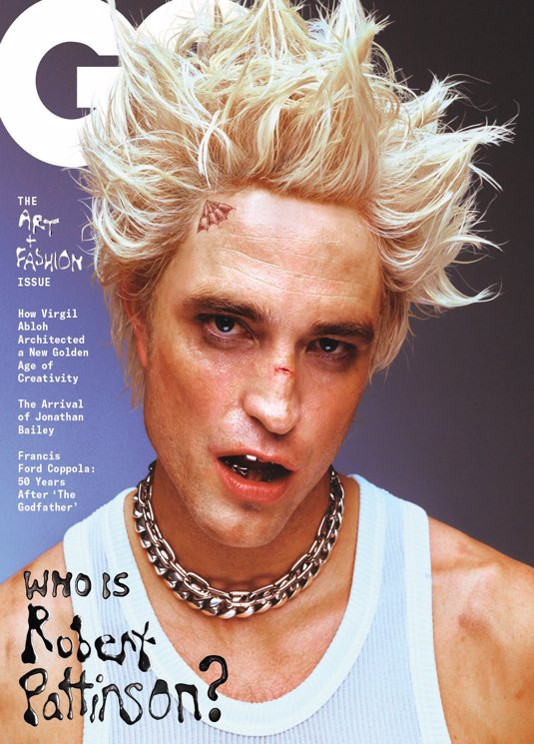
Cover Page
ACTIVITY 1: Label the GQ Cover using the terms featured on slide 1.

Slide 5
Activity 2: Applying Technical Codes to GQ
Code | Example (Denotation) | Meaning (Connotation)
Layout
Typography
Photography

Slide 6
SEMIOTICS : Paradigm and Syntagm
Activity 3: Using the article, text book or any other study resource, find definitions for each of these ideas and give examples to show how they are used in GQ to create meaning.
Term and Definition | Example
Paradigm
Syntagm

Slide 7
SEMIOTICS : Anchorage and Relay
Activity 4: Using the article, text book or any other study resource, find definitions for each of these ideas and give examples to show how they are in GQ magazine to create meaning.
Term and Definition | Example
Anchorage
Relay

Slide 8
MODE OF ADDRESS
Direct Modes e.g. In mise-en-scene character gaze can be directed at the audience or at someone else in the text. Does the character ever look directly at the audience – what impact does this have? In written language (symbolic code) is the audience addressed directly in the 2nd person i.e. “you” – what impact could that have?
Indirect Modes use mise-en-scene where the actors never look at the camera and language which focussed or 3rd person voice i.e. “the/he/she/it”- what impact could this have?
Formal Modes use elaborated codes or formal language styles e.g. scientific jargon or addressing characters by their full names and titles – what impact could that have?
Informal Modes use restricted codes , informal language styles such as slang – what impact could that have?
ACTIVITY 5: Using the items from the GQ March 2022 edition, try to identify specific examples of each of the above in action and talk about the potential impact of each on the target audience.
NOTE – AUDIENCE POSITIONING: How are the audience being spoken to by the producers of the text?
EXT.– What is meant by the term extra-diegetic gaze and what potential impact would this technique have on an audience?

Slide 9
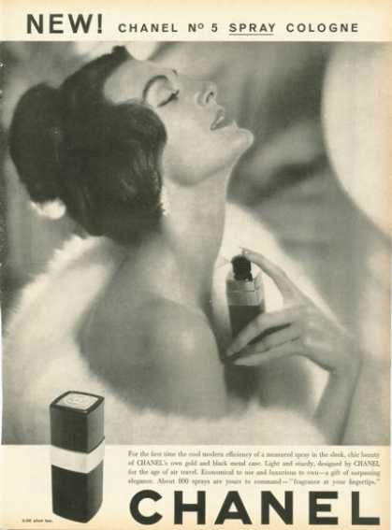
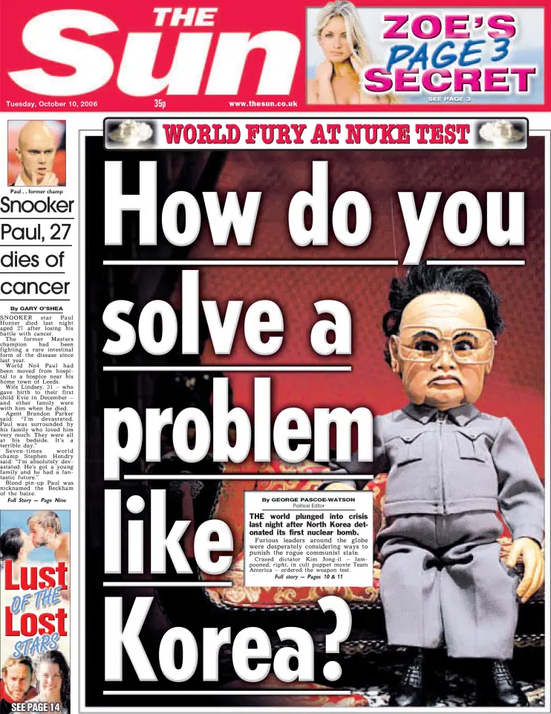
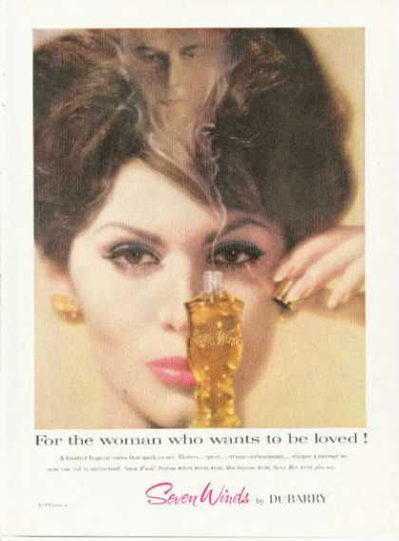
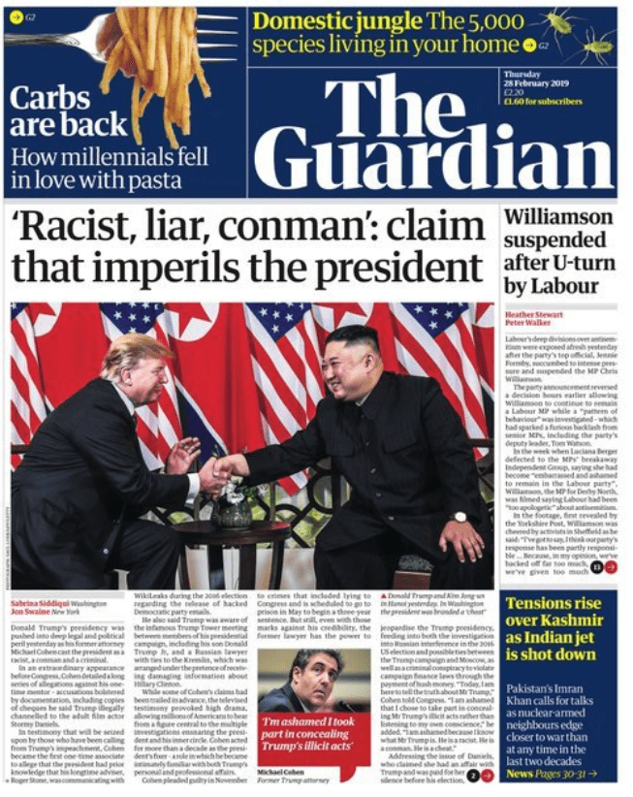
EXAMPLES
TASK: Identify examples of direct, indirect, formal or informal modes of address featured in the media texts above.

Slide 10
NARRATIVE THEORY (NARRATOLOGY)
Todorov – Identifies key elements of Narrative structure which are expressed in terms of Equilibrium (the existing power balance featured in the world of the characters)/Disequilibrium (the conflict)/New Equilibrium (The new power balance).
Propp – Identifies 8 essential character types in a text : Hero, Villain, Donor, Dispatcher, Helper, False Hero, The Princess, Her Father
Levi-Strauss – Identifies Binary Oppositions or opposing forces which are used to create sense of drama within the text e.g. good-vs evil, man vs. woman etc.
Barthes – Action Codes (e.g. chases, fights or any kind of movement featured in the text) and Enigma Codes which cause the audience to ask questions, create a sense of mystery and intrigue e.g. Who will be the next winner of the X Factor?

Slide 11
Activity 6: Applying Narrative Theory: GQ Magazine
Theorist | Application (using example from text)
Levi Strauss Binary Oppositions Mytheme (EXT) | 1) 2) 3) 4) 5)
Todorov Equilibrium: Disruption: New Equilibrium: | 1) 2) 3)
Propp Character Types | 1) 2) 3) 4)
Barthes Enigma Codes: Action Codes: | 1) 2)

Slide 12
Magazine Production Task Due date – Wednesday 30th November
Create a front cover for a monthly magazine on one of the following special interest subjects: Pets, Fashion or Gossip
Your magazine cover needs to have the following features:
An original title and masthead
An original focal image
A date, issue number, barcode and price (PUGs)
A selling line
At least 4 Cover Lines
The final piece should also be accompanied by a 300-400 word statement of intent – see next slide for details.

Slide 13
STATEMENT OF INTENT (300-400 words)
The statement of intent should be structured in 3 paragraphs :
“The topic for magazine is … and then explain why you chose this particular topic. Is there a market for this type of magazine? Where is your evidence? Which titles are your main competitors (hint: you may need to undertake research into similar titles)
“My target audience are … (age/gender/class)
“I have decided to use specific images and words because…” explain how the selection (paradigm) and combination (syntagm) of words and images will appeal to your target audience. Remember to justify your title name and masthead design, focal image, fonts and colour palette used and mode of address. You should also try to identify instances of anchorage and relay in the language featured on the cover.
Ext. Apply a specific narrative theory to your cover.

Slide 14
How You’ll Be Assessed
This task focuses on this specific assessment objectives related to the AQA Media syllabus:
• AO3: Create media products for an intended audience by applying knowledge and understanding of the theoretical framework of media to communicate meaning. This will be assessed by judging the quality and appropriateness of your charity advert and statement of intent in relation to the aims of the brief.
The task is marked out of 20.
Your marks for the task will be awarded in line with the following mark scheme:
Level 1: (1- 2 marks) Ineffectual/Incomplete - An ineffectual product that would have minimal or no appeal to its designated audience, communicates little discernible meaning, very limited, if any, use of conventions appropriate to the specified Industry, meeting very few of the requirements of the task.
For marks towards the top of the band this must be, at least, a recognisable media product
Level 2 : (3-6 marks ) Basic – Would only have limited appeal to the audience;communicates a few basic meanings; features emerging use of conventions appropriate to the specified industry; meets some of the requirements of the task though some elements may be incomplete.
Level 3 : (7-10 ) Satisfactory – communicates some relevant meanings; features some use of conventions appropriate to the specified industry; meets most of the requirements of the task.
Level 4 : (11- 15 ) Good - clearly communicates generally relevant meanings; frequently uses of conventions appropriate to the specified industry; meets almost all of the requirements of the task.
Level 5 : (16- 20 ) Excellent - effectively communicating relevant meanings; consistently uses of conventions appropriate to the specified industry; meets all the requirements of the task.

