Slide 1
Audience Reception Theory

Slide 2
AGENDA SETTING
FRAMING
MYTH MAKING
CONDITIONS OF CONSUMPTION

Slide 3
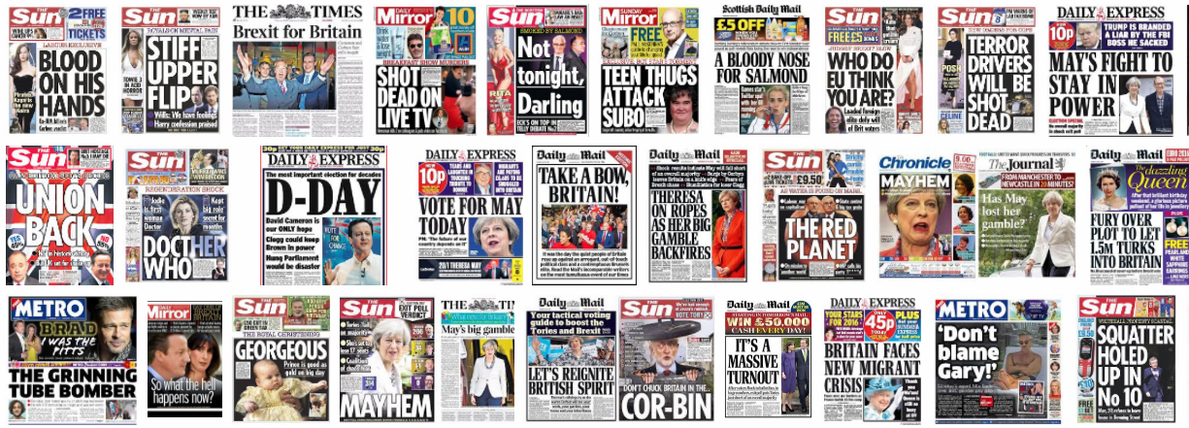
WHAT KEY ISSUES CAN YOU IDENTIFY HERE?

Slide 4
AGENDA SETTING
Agenda-setting is the creation of public awareness and concern of the big issues by the news media.
The media attempts to influence viewers, and establish a hierarchy of news importance.
Two basic ideas underpin agenda-setting:
  the press and the media do not reflect reality; they filter and shape it
  media concentrates on a few issues and subjects leads the public to perceive those issues as more important than other issues.
What is important
What is the current news media agenda?

Slide 5
Current news media agenda
Tax system
Royal family
Immigration
Terrorism
Paedophiles
The internet/hackers/grooming
These are staples that are regularly seen in the media. Other parts of the agenda may be altered or triggered by a specific event.

Slide 6
Daily Mail’s ideological Agenda and view of the world: can you discover articles that relate to the ideas below?
Daily Mail features often articles that celebrate the public and private lives of the Royal Family. The monarchy is presented as a high ideal, a force that brings the nation together. Texts and images present the royals as iconic symbols of British values, elegance and glamour.
In politics, the Daily Mail supports the Tories and has overall rightwing and neo-liberal ideas on economy and society. It espouses less state, private enterprise and is critical of public services and trade unions.
It presents the immigration/refugee crisis through the lens of moral panic. Immigrants are presented as form of disorder, threat and danger. They are also discussed a burden to taxpayers. Sensational language raise concerns over illegal border crossing and immigrant criminality
A series of articles present pro-Palestine protesters as public disruption and ‘hate-mobs’
Daily Mail celebrates ‘tax cuts’ and presents benefit-claimants as immoral citizens who take advantage of the hard work of tax-payers.
The newspaper is very suspicious of vaccines and the overall restrictions imposed during the Covid Epidemic.
Daily Mail reporters and column writers often express strong skepticism over trans rights.

Slide 7
Use the link below and explain what is the ideological agenda of Guardian?
https://www.theguardian.com/world/world+tone/editorials

Slide 8
The Guardian’s agenda

Slide 9
Guardian’s agenda
The Guardian is a centre-leftwing newspaper with liberal ideas on society and culture.
It is highly critical of Tory governments and ideology and features articles that criticize neo-liberal policies (Thatcherism).The newspaper is against m cuts-funding for public services such health, education and the arts.
It is critical of the asylum and immigration policies of the Tory government and raises concerns about racial forms discrimination
It supports gay, trans and feminist causes.
It raises issues concerning the plight of Palestinians in the Gaza war and is critical of US approach to this issue.

Slide 10
FRAMING
how something is presented to the audience (called “the frame”) influences the choices people make about how to process that information.
The most common use of frames is in terms of the frame the news or media place on the information they convey.
a form of second level agenda-setting – they not only tell the audience what to think about (agenda-setting theory), but also how to think about that issue (framing theory).
What to think about the issues

Slide 11
Factors to influence framing.
Politics
Gender
Age
Religion
Culture/society (trends)
Economic issues and the influence of sponsors and money.

Slide 12
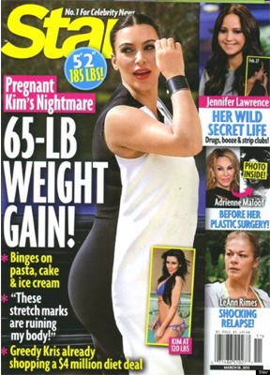
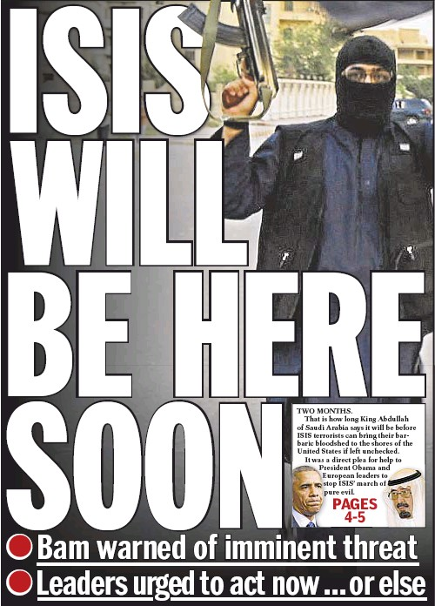
Media myth making
The influence of agenda setting and framing can create myths- common beliefs- in the media about how the world should be, the things we value and how we must act to become ‘correct’.
What myths could we see in these two media products?

Slide 13
MYTH #1. The world is a dangerous place. We need protecting.
MYTH #2. Leave it to the experts
MYTH #3. The good life consists possessions/money.
MYTH#4. Happiness, satisfaction and sex appeal etc. are available with the next consumer purchase.
MYTH #5. Your body is not good enough.
MYTH #6. Businesses and corporations are concerned for the public welfare.
Can you think of examples of places these myths are commonly shown?

Slide 14
Conditions of consumption.
So we have media that has been framed and presented to us in order to meet an agenda or support a myth.
Do we just accept it?
What other things can help shape our reception of the media messages?

Slide 15
Other things that can affect our interpretations
Daily lives
Routines
Upbringing
Education
Friendship groups
Relationships
OTHER THINGS CAN AFFECT HOW WE VIEW MEDIA MESSAGES.

