Slide 1
Media Language
The Language of Print (inc rule of thirds)

Slide 2
The Language of Print?
Layout
Rule of 1/3rds
Blank/white space
Size
Position
Orphans
Widows
Gutters/borders
Juxtaposition
Hard lines
Graphic feature
Watermark
Drop cap
Columns
Paragraphs
Plugs / Ears
Page numbers
Date issue no.
Colour blocks
gradient
Task 1 Arrange key words under correct heading
Image
Photograph
caption
Illustration
Logo
Crop
Depth of field
Perspective
Shutter speed
Colour
contrast
Texture
Setting
NVC
Text
Font type
Font size
Serif / sans serif
Colour
Italic/bold
Underline
Title banner
Heading
Subheading
Leading line
Tag-line
By line
Structuring / sequencing
Institutional information
Adverts

Slide 3
The Language of Print?
Layout
Rule of 1/3rds
Blank/whit space
Size
Position
Orphans
Widows
Gutters/borders
Juxtaposition
Hard lines
Graphic feature
Watermark
Drop cap
Columns
Paragraphs
Plugs / Ears
Page numbers
Date issue no.
Colour blocks
gradient
Task 1 Arrange key words under correct heading
Image
Photograph
caption
Illustration
Logo
Crop
Depth of field
Perspective
Shutter speed
Colour
contrast
Texture
Setting
NVC
Text
Font type
Font size
Serif / sans serif
Colour
Italic/bold
Underline
Title banner
Heading
Subheading
Leading line
Tag-line
By line
Structuring / sequencing
Institutional information
Adverts

Slide 4
Add semiotic terms
an iconic sign,
an indexical sign,
a symbolic sign,
Dominant Signifier,
Anchorage,
Paradigm,
Syntagm,
Myth,
Representations of the dominant Ideology,
Representations that may challenge the dominant ideology
A radical text
A reactionary text.

Slide 5
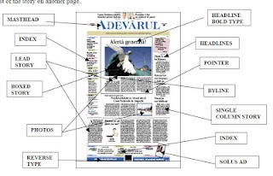
In groups of 3 (that have different front covers) 1. Put the print language and the semiotic words around your examples 2. Annotate (when necessary) 3. Take a photo 4. Upload to blog

Slide 6
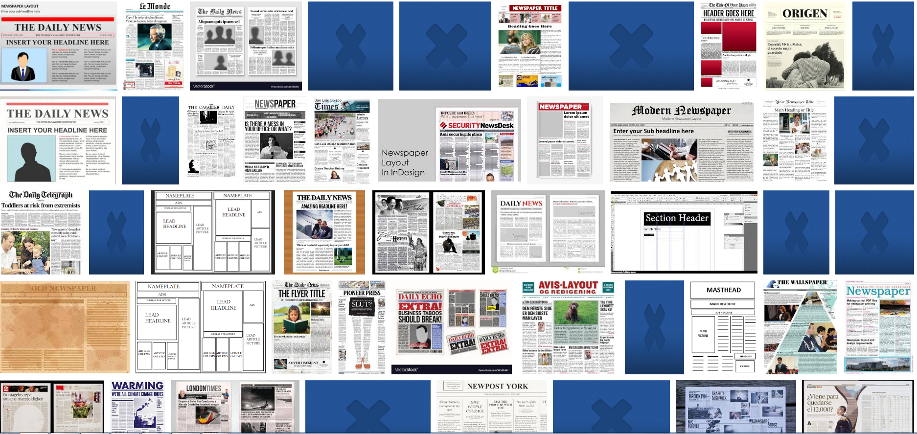
Designing a front cover
If you could design a front cover of a newspaper what would it look like? What would be in it?

Slide 7
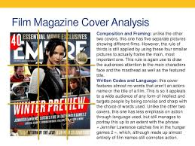
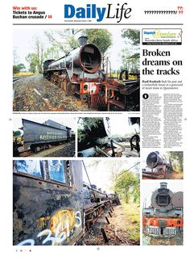
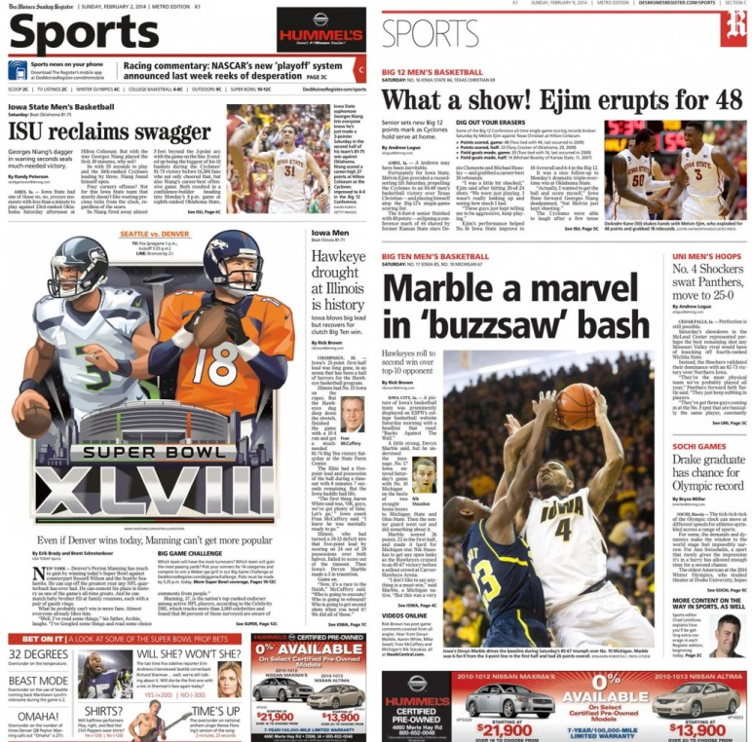
Use a piece of paper and the rule of 1/3rds

