Slide 1
Audience Reception Theory

Slide 2
AGENDA SETTING FRAMING MYTH MAKING CONDITIONS OF CONSUMPTION

Slide 3
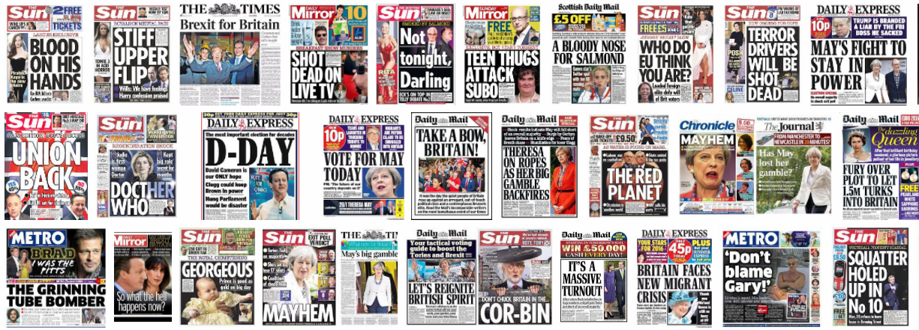
WHAT KEY ISSUES CAN YOU IDENTIFY HERE?

Slide 4
AGENDA SETTING
Agenda-setting is the creation of public awareness and concern of the big issues by the news media.
The media attempts to influence viewers, and establish a hierarchy of news importance.
Two basic ideas underpin agenda-setting:
the press and the media do not reflect reality; they filter and shape it
media concentrates on a few issues and subjects leads the public to perceive those issues as more important than other issues.
What is important
What is the current news media agenda?

Slide 5
Current news media agenda
Brexit
Immigration
Terrorism
Paedophiles
The internet/hackers/grooming
These are staples that are regularly seen in the media. Other parts of the agenda may be altered or triggered by a specific event.

Slide 6
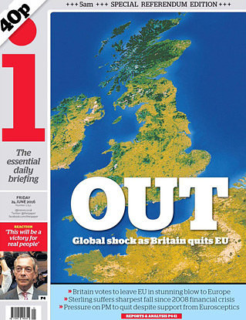
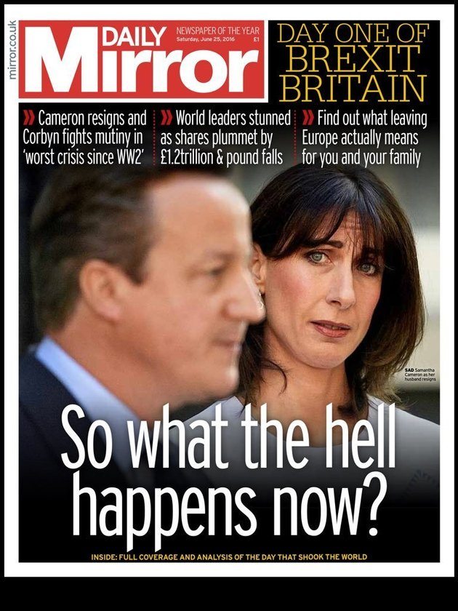
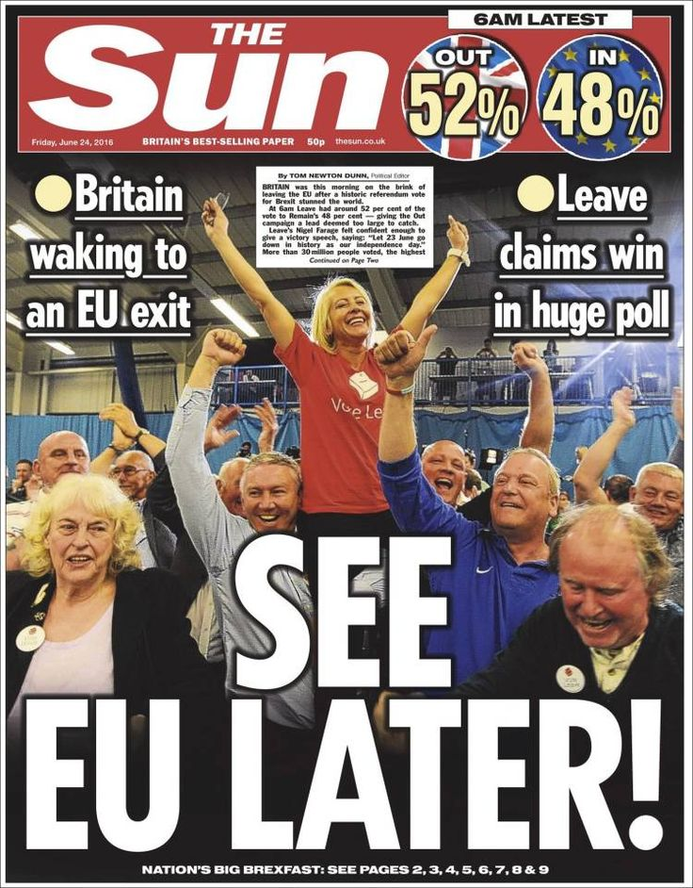
How do these publications feel about Brexit and how do you know?

Slide 7
FRAMING
how something is presented to the audience (called “the frame”) influences the choices people make about how to process that information.
The most common use of frames is in terms of the frame the news or media place on the information they convey.
a form of second level agenda-setting – they not only tell the audience what to think about (agenda-setting theory), but also how to think about that issue (framing theory).
What to think about the issues

Slide 8
WHY do these publications feel about differently about Brexit?

Slide 9
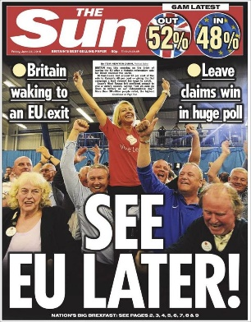
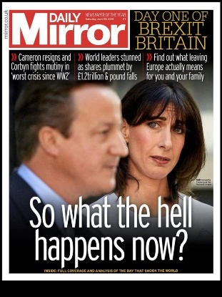
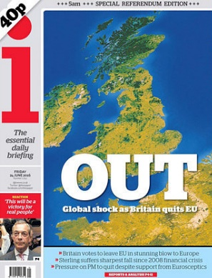
Political bias
The Sun is very PRO BREXIT.
The Mirror is not totally against BREXIT, but is pro-labour, so will criticise the Conservatives.
The Independent is trying to remain more neutral on the subject – hence the name!
What other factors may affect the framing of news media?

Slide 10
Factors to influence framing.
Politics
Gender
Age
Religion
Culture/society (trends)
Economic issues and the influence of sponsors and money.

Slide 11
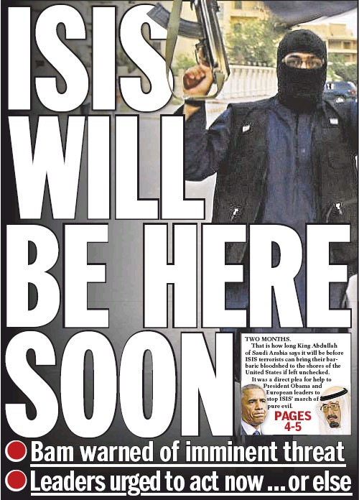
Media myth making
The influence of agenda setting and framing can create myths- common beliefs- in the media about how the world should be, the things we value and how we must act to become ‘correct’.
What myths could we see in these two media products?

Slide 12
MYTH #1. The world is a dangerous place. We need protecting.
MYTH #2. Leave it to the experts (usually white men).
MYTH #3. The good life consists possessions/money.
MYTH#4. Happiness, satisfaction and sex appeal etc. are available with the next consumer purchase.
MYTH #5. Your body is not good enough.
MYTH #6. Businesses and corporations are concerned for the public welfare.
Can you think of examples of places these myths are commonly shown?

Slide 13
Conditions of consumption.
So we have media that has been framed and presented to us in order to meet an agenda or support a myth.
Do we just accept it?
What other things can help shape our reception of the media messages?

Slide 14
Other things that can affect our interpretations
Daily lives
Routines
Upbringing
Education
Friendship groups
Relationships
OTHER THINGS CAN AFFECT HOW WE VIEW MEDIA MESSAGES.

