Slide 1
NEA Film : Amnesia
By Josh Wright

Slide 2
Plot
The plot of the film follows the story of a man waking up in an unfamiliar environment and discovering the reason for why he is there.
We then see the main protagonist knock on the door and enter the home with the goal of robbing the man.
The film then cuts to the present where he is awake and has realised what he's done, he walks to the door and police sirens are heard.
As the film goes on there is subtle pieces of foreshadowing that hint towards the origin of the reason for the man waking up in this environment
Whilst talking he slips in powder into the homeowner's coffee resulting in the homeowner falling unconscious.
The man discovers an unconscious man in the house and recalls the reason for why he is in the house and why the man is unconscious.
He then begins looting and robbing the house, this makes the man tired and results in him drinking the coffee to quench his thirst.
A flashback plays of the man who was unconscious waking up in his bed and starting his day-to-day activities.
He goes into the other room to loot more items and falls unconscious due to the spiked coffee.

Slide 3
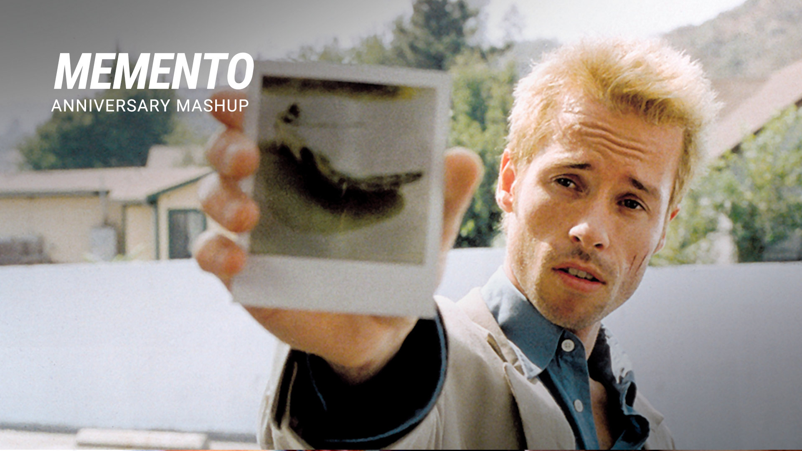
How does it fit with the NEA brief and inspirations
Casting and Location
The film with have only two characters as I have the task of fleshing out the characters in a short amount of time meaning I can only make two characters with clear goals and ambitions.
The style of the film features a nonlinear narrative due to the themes of Amnessia being the driving force of the film. I chose non a nonlinear story to throw the audience off guard and increase suspense.
Burglar: The burglar is played by Harry Berry
Homeowner: The homeowner is played by Oisin Martin Foley,
The film draws inspiration from the Christopher Nolan film called Memento. The film was released in the year 2000. The plot follows a man with anterograde amnesia who is unable to form new memories. The film makes use of a nonlinear plot to show chronological and non-chronological scenes.
Location: Harry’s House
This is like my film as it has in common the non-linear style with the theme of Amnesia.

