Slide 1
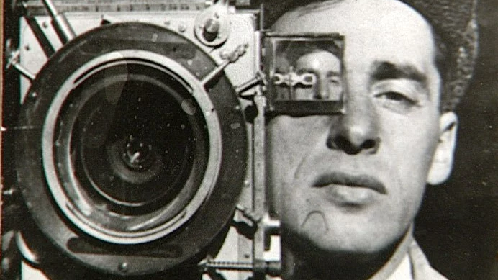
Cinematography Introduction to Film Elements Area 1
STARTER ACTIVITY:
Find a definition of the terms Cinematography and Cinematographer
Extension: How is a Cinematographer’s role different to that of a Director?

Slide 2
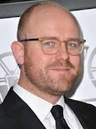
The Cinematography of Moonlight
Moonlight (Jenkins, 2016)
James Laxton –Cinematographer

Slide 3
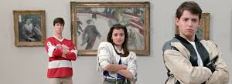
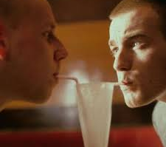
Cinematography and Diegesis
In cinematic terms the term diegesis basically refers to “the world of the film”.
There are three terms which explain the relationship between the audience and this world – diegetic, intra-diegetic and extra-diegetic.
Diegetic perspective or “gaze” is expressed in terms of how the audience is being asked to look at the content or subjects on screen by the director e.g. what is being emphasised using a close- up?
The intra-diegetic gaze is when the audience are put in the place of a character and being asked to see things from their viewpoint e.g. using subjective camerawork in films like Cloverfield
The extra-diegetic gaze is when someone on screen addresses the audience directly by looking directly down the lens of the camera– sometimes known as “breaking the 4th wall”. Not to be confused with the above when the audience are being asked to the “perspective” of another character.
ACTIVITY 1 :Find examples from Moonlight for each of the three terms and explain the impact or effect these techniques have had on you as a viewer.

Slide 4
Shots, Movements and Angles
Shot Types: Big or Extreme Close Up (BCU/ECU) Close Up (CU) Medium Close Up (MCU) Medium or Mid Shot(MS), Medium Long Shot (MLS), Long Shot(LS), Very or Extreme Long Shot (VLS/ELS) Panoramic Shot.
Camera Movement: Track, Crab or Truck , Ped or Pedestal, Pan, Tilt, Crane, Dolly, Zoom, Crash Zoom.
Camera Angles: High Angle Shot, Low Angle Shot, Birds Eye View, Worms Eye View, Dutch Tilt or Canted Shot.

Slide 5
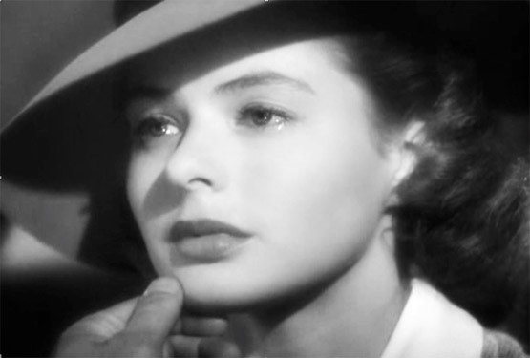
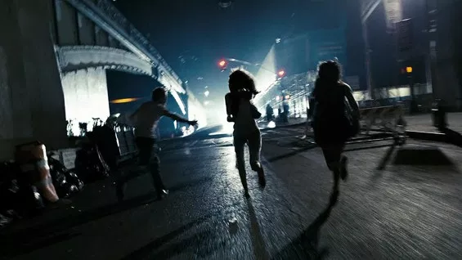

Slide 6
Shot Distances
ACTIVITY 2
Give an example of where at least 3 of these shots were used in the film Moonlight and explain the effect on you as a viewer.
Extension: Address all of them.

Slide 7
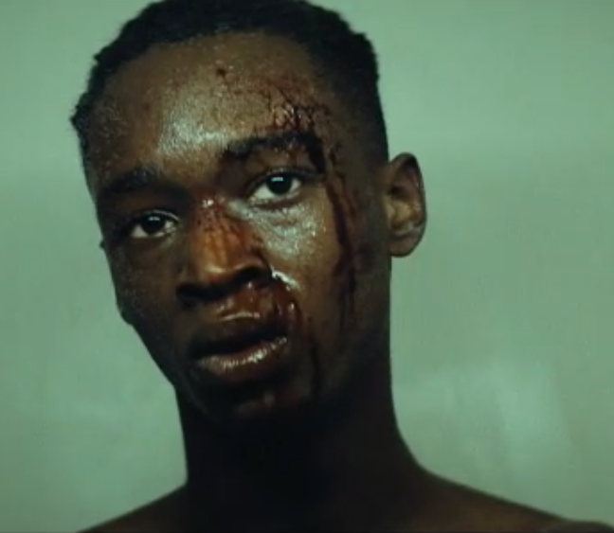
Close up camera shot
This is a closeup as the camera is cut off at his shoulders and his head is taking up about 60% of the screen

Slide 8
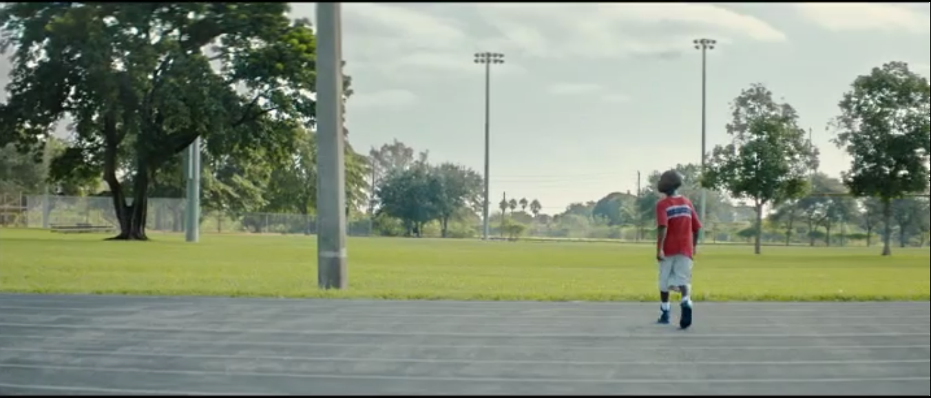
Long shot
This is a long shot as you can see the whole character and the background around him. He is fairly far away from the camara

Slide 9
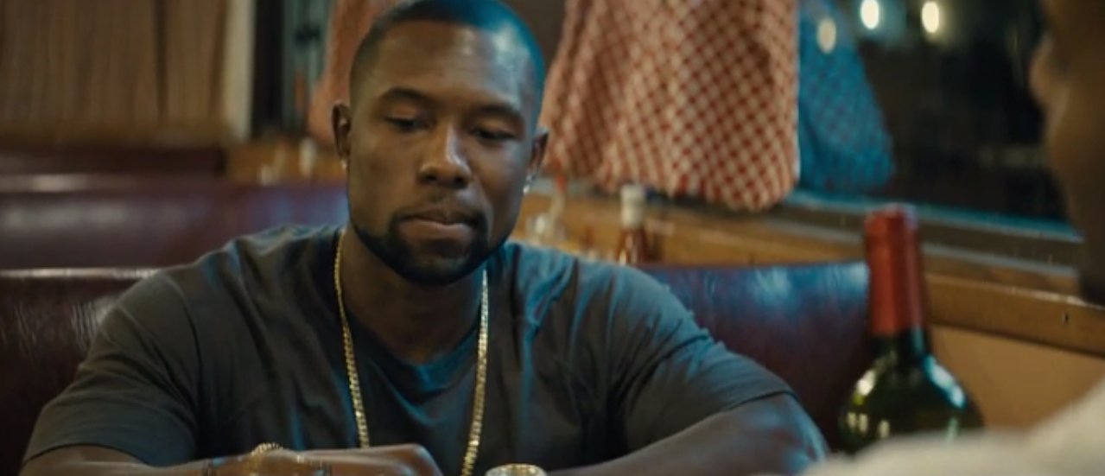
Medium close up shot
This shot is a medium close up because only half of his body is in the frame

Slide 10
Camera Angles
ACTIVITY 3
Give an example of where at least 3 of these angles were used in Moonlight and explain the effect on you as a viewer.
Extension: Address all of them.

Slide 11
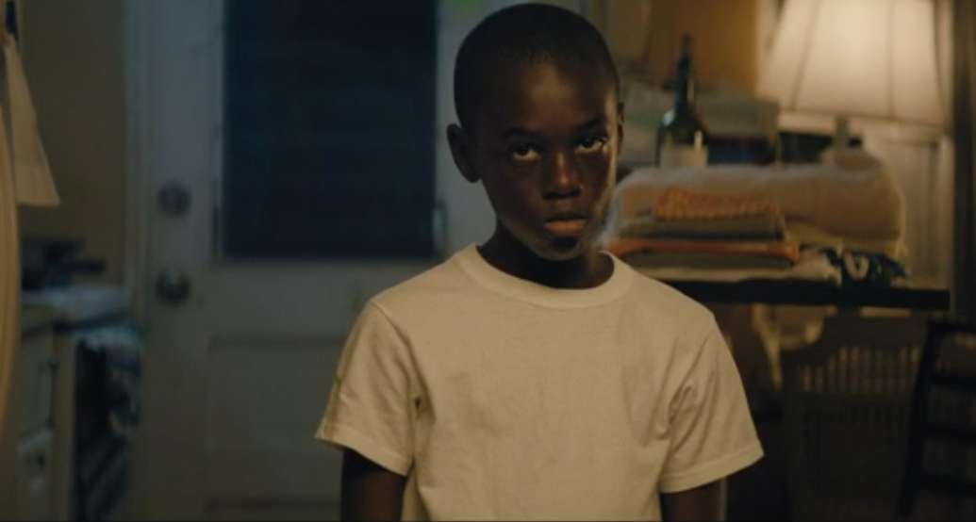
Eye level shot this is an example of an eye level shot as the camera is level with the actors eyes

Slide 12
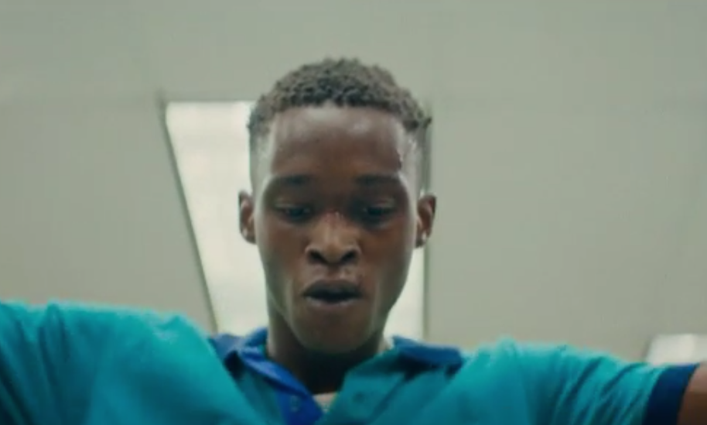
Low angle shot this is an example of a low angle shot as the camera is below the actor

Slide 13
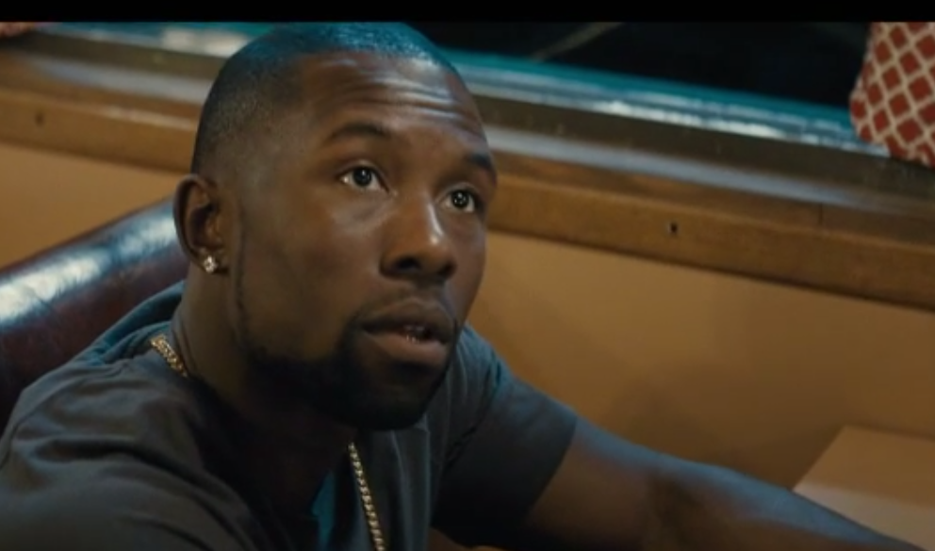
High angle shot This is an example of a high angle shot as the camera is above the actor

Slide 14
Camera Movements
ACTIVITY 4
Give an example of where at least 3 of these movements were used in Moonlight and explain the effect on you as a viewer
Extension: Address all of them.

Slide 19
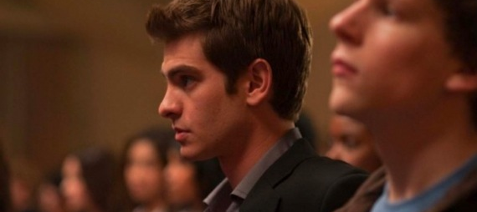
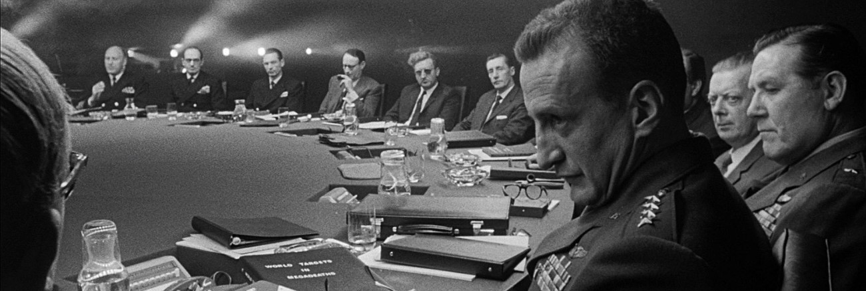
Depth of Field
ACTIVITY 5
Explain the concept of depth of field in cinematographic terms.
Additionally, ensure that you have defined the terms shallow focus and deep focus.
Finally given an example of where depth of field has been used by the cinematographer James Laxton in Moonlight

