Slide 1
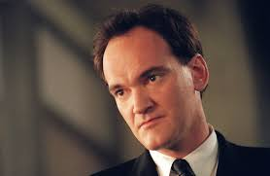
Quentin Tarantino
An American Film Diercetor

Slide 2
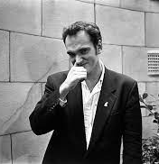
Biography
He was born in Knoxville, Tennessee on March 27th in 1963.
As of 2022 he is 59 years old.
He was born into a family of talent as his father was an actor and musician from New York named Tony Tarantino.
However, his mother was just a nurse and fell pregnant with him at the age of 16 whilst being married to his father however they are believed to of split up shortly after his birth.

Slide 3
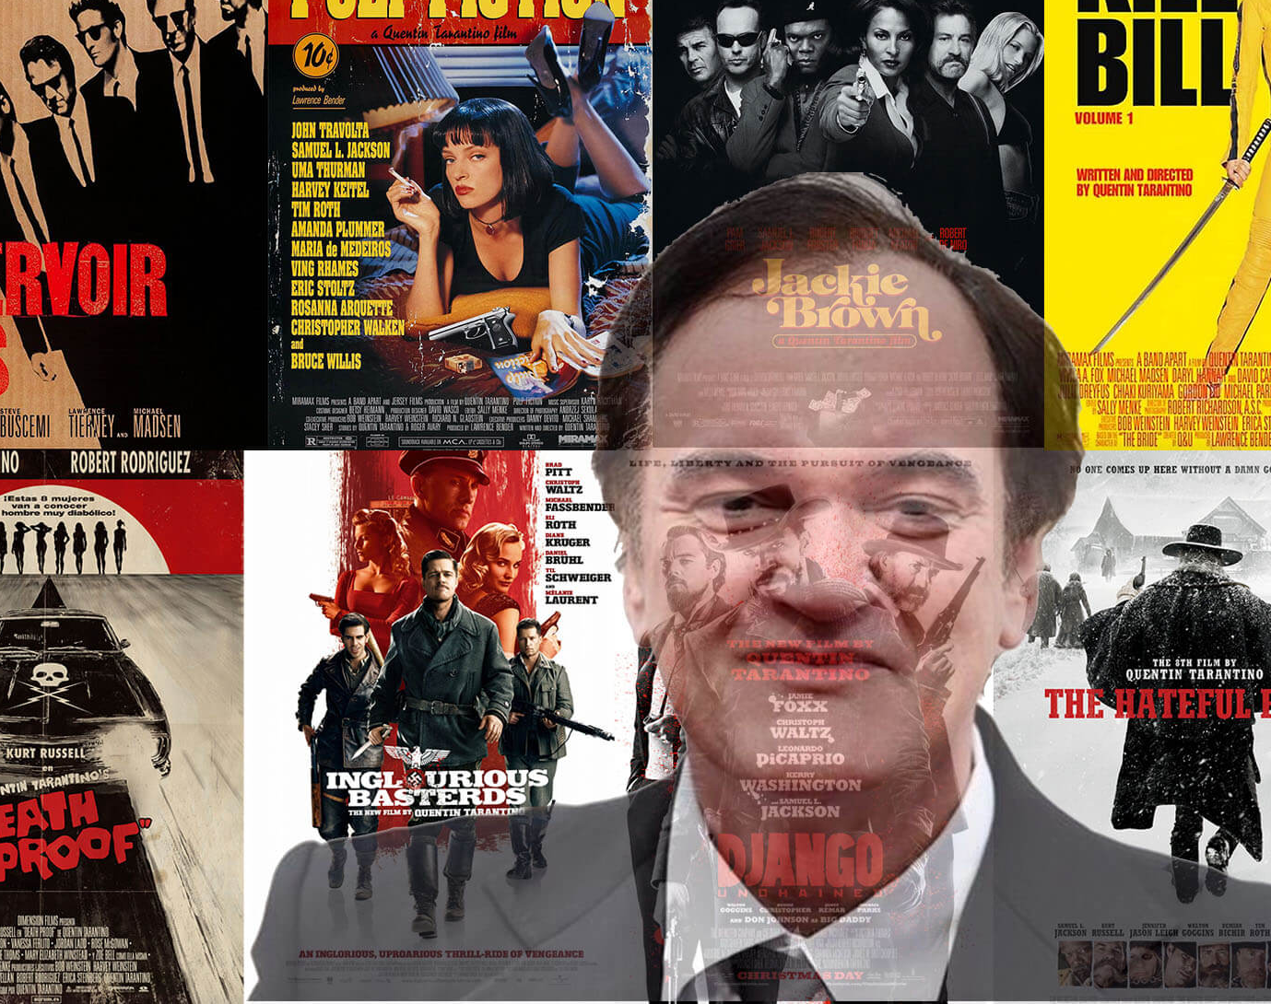
Filmography
My Best Friends Birthday (1987)
Reservoir Dogs (1992)
Pulp Fiction (1994)
Jackie Brown (1997)
Kill Bill: Volume 1 (2003)
Kill Bill: Volume 2 (2004)
Grindhouse: Death Proof (2007)
Inglorious Bastards (2009)
Django Unchained (2012)
The Hateful Eight (2015)
Once Upon a Time in Hollywood (2019)

Slide 4
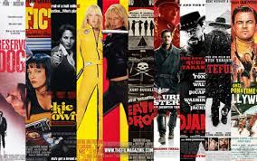
Genre
Action
Crime fantasies
Dark Comedies

Slide 5
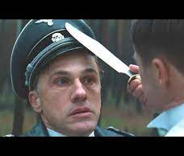
Narrative themes
Revenge
Deception
Redemption

Slide 6
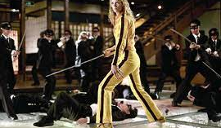
Message and values
All humans are inheritably violent and lawless with us being capable of many bad things if pushed far enough.

Slide 7
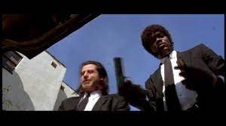
Cinematography
The trunk & hood POV
The corpse POV
The 360 shot
God’s eye POV
He frequently makes use of black and white within certain scenes.

Slide 8
Editing
Opening Definitions
The films are usually separated into segments called “acts”
During production he doesn’t enter the editing room as he doesn’t want to see any edited footage until everything is filmed even though he is involved with every part of his films creative process.

Slide 9
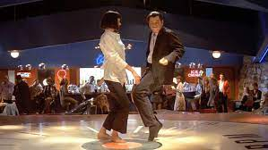
Soundtrack
Many of Tarantino's films include needle drops and songs that were popular at the time the film was set.
An example of this is the dance scene from Pulp Fiction.
If the music is original, Tarantino will collaborate with Enino Morricone

Slide 10
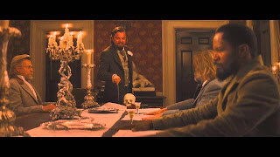
Mise En Scene
Lots of periodically correct props and costumes have been made and used. This is to make the scene seem like an authentic location.
For example, in this scene the lighting has been dampened in order to give the impression of candlelight.

Slide 11
sources
Messages- https://www.quora.com/Do-Tarantino-movies-have-messages
Biography- https://www.britannica.com/biography/Quentin-Tarantino
Filmography- https://en.wikipedia.org/wiki/Quentin_Tarantino_filmography
Genre- https://en.wikipedia.org/wiki/Quentin_Tarantino
Narrative themes-https://movies.stackexchange.com/questions/60905/do-all-of-quentin-tarantinos-movies-have-a-common-underlying-theme
Messages- https://www.quora.com/Do-Tarantino-movies-have-messages
Cinematography- https://www.catchplay.com/sg/ed-says/article-3139-ta8d0dr0
Editing- https://cinemontage.org/fred-raskin-talks-about-editing-quentin-tarantinos-once-upon-a-time-in-hollywood/
Soundtrack- https://screenrant.com/best-ennio-morricone-music-moments-quentin-tarantino-movies/#:~:text=Tarantino's%20favorite%20composer%20is%20Ennio,classics%20they%20were%20recorded%20for.
Mise En Scene- http://dionsfilmspotlight.blogspot.com/

