Slide 1
Key Films and Directors in Hollywood in 1920s

Slide 2
Key Films
1920- Dr. Jekyll and Mr. Hyde
1921- The Four Horsemen of the Apocalypse
1922- Robin Hood
1923- The Hunchback of Notre Dame
1924- He Who Gets Slapped
1925- The Phantom of the Opera
1926- The Son of the Sheik
1927- Metropolis
1928- Noah's Ark
1929- The Broadway Melody

Slide 3
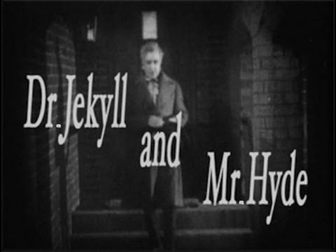
1920- Dr. Jekyll and Mr. Hyde
Director: John S. Robertson
Gross: $1,300,000

Slide 4
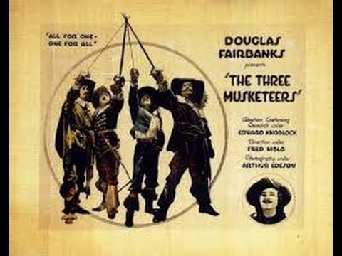
1921- The Three Musketeers
Director: Fred Niblo
Gross: $2,000,000

Slide 5
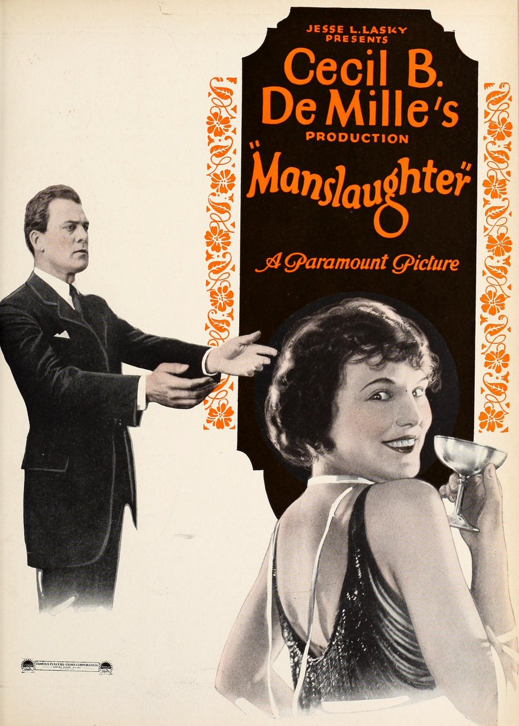
1922- Manslaughter
Director: Cecil B. DeMille
Gross: $1,200,000

Slide 6
1923- The Hunchback of Notre Dame
Director: Wallace Worsley
Gross: $3,500,000

Slide 7
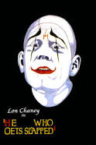
1924- He Who Gets Slapped
Director: Victor Sjöström
Gross: $881,000

Slide 8
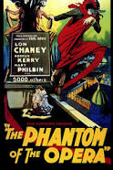
1925- The Phantom of the Opera
Director: Rupert Julian
Gross: $2,000,000

Slide 9
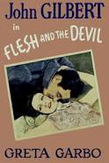
1926- Flesh and the Devil
Director: Clarence Brown
Gross: $1,261,000

Slide 10
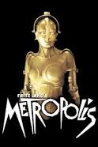
1927- Metropolis
Director: Fritz Lang
Gross: $1,236,166

Slide 11
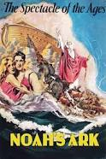
1928- Noah's Ark
Director: Michael Curtiz
Gross: $2,305,000

Slide 12
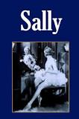
1929- Sally
Director: John Francis Dillon
Gross: $2,198,000

