Slide 1
Film in the 1900s
Murray watson

Slide 2
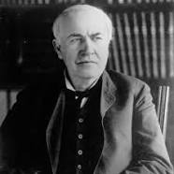
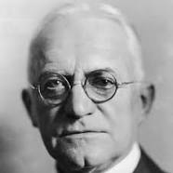
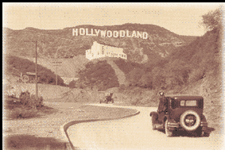
Moving to Hollywood
In the early 20th Century, renowned scientist Thomas Edison, who was responsible for the invention of the lightbulb, obtained a considerable monopoly over film production due to his patent with the invention of the film camera, using celluloid film invented by George Eastwood, which made it hard for filmmakers as Edison was so influential in what was and was not happening in the industry. As Edison situated his empire in New Jersey, filmmakers began journeying to California in order to escape his heinous overrule.

Slide 3
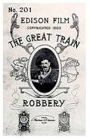
Iconic film in the 1900s
Two notable films of the 1900s are A Trip to the Moon and The Great Train Robbery. Trip to the moon is significant as the plot of journeying to the moon and meeting conflict was an idea greatly innovative as in relation to the time, this was generally unprecedented.
At twelve minutes long, The Great Train Robbery film is considered a milestone in film making, expanding on Porter's previous work Life of an American Fireman. The film used a number of then-unconventional techniques, including composite editing, on-location shooting, and frequent camera movement.

Slide 4
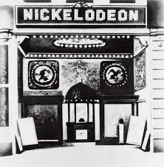
Theatres
In 1905, the introduction of nickelodeons boomed a popularity for film in America in the start of the 20th century. Between 1905 and 1907, the amount of nickelodeon theatres had doubled to aan estimated 8000, with the aid of wealthy, ambitious entrepreneurs. It was estimated that approximately 26 million American citizens were visiting these theatres weekly from when they started up in 1905 to 1910

Slide 5
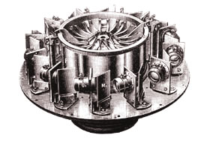
The Photorama
1900 LUMIERE AND SONS / THE PHOTORAMA At the Paris International Exhibition of 1900, the Lumière's (Auguste and Louis) presented their Photorama Lumière, a 360 degree panoramic projector which used 70mm film and an analyphic stereoscopic motion picture system which was later introduced in 1935. The Lumière Photorama was a process for wide screen static projection. The screen was between 20 and 21 metres in circumference and six metres high. The system used revolving lenses (image below) to project that of landscapes, riverscapes and cityscapes. Even though static, the Photorama depended upon persistence of vision as is the case with Cinematography.

