Slide 1
Film in the 1900's
By: Sammy, Ayisha, Kacper

Slide 2
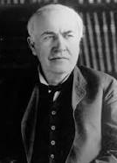
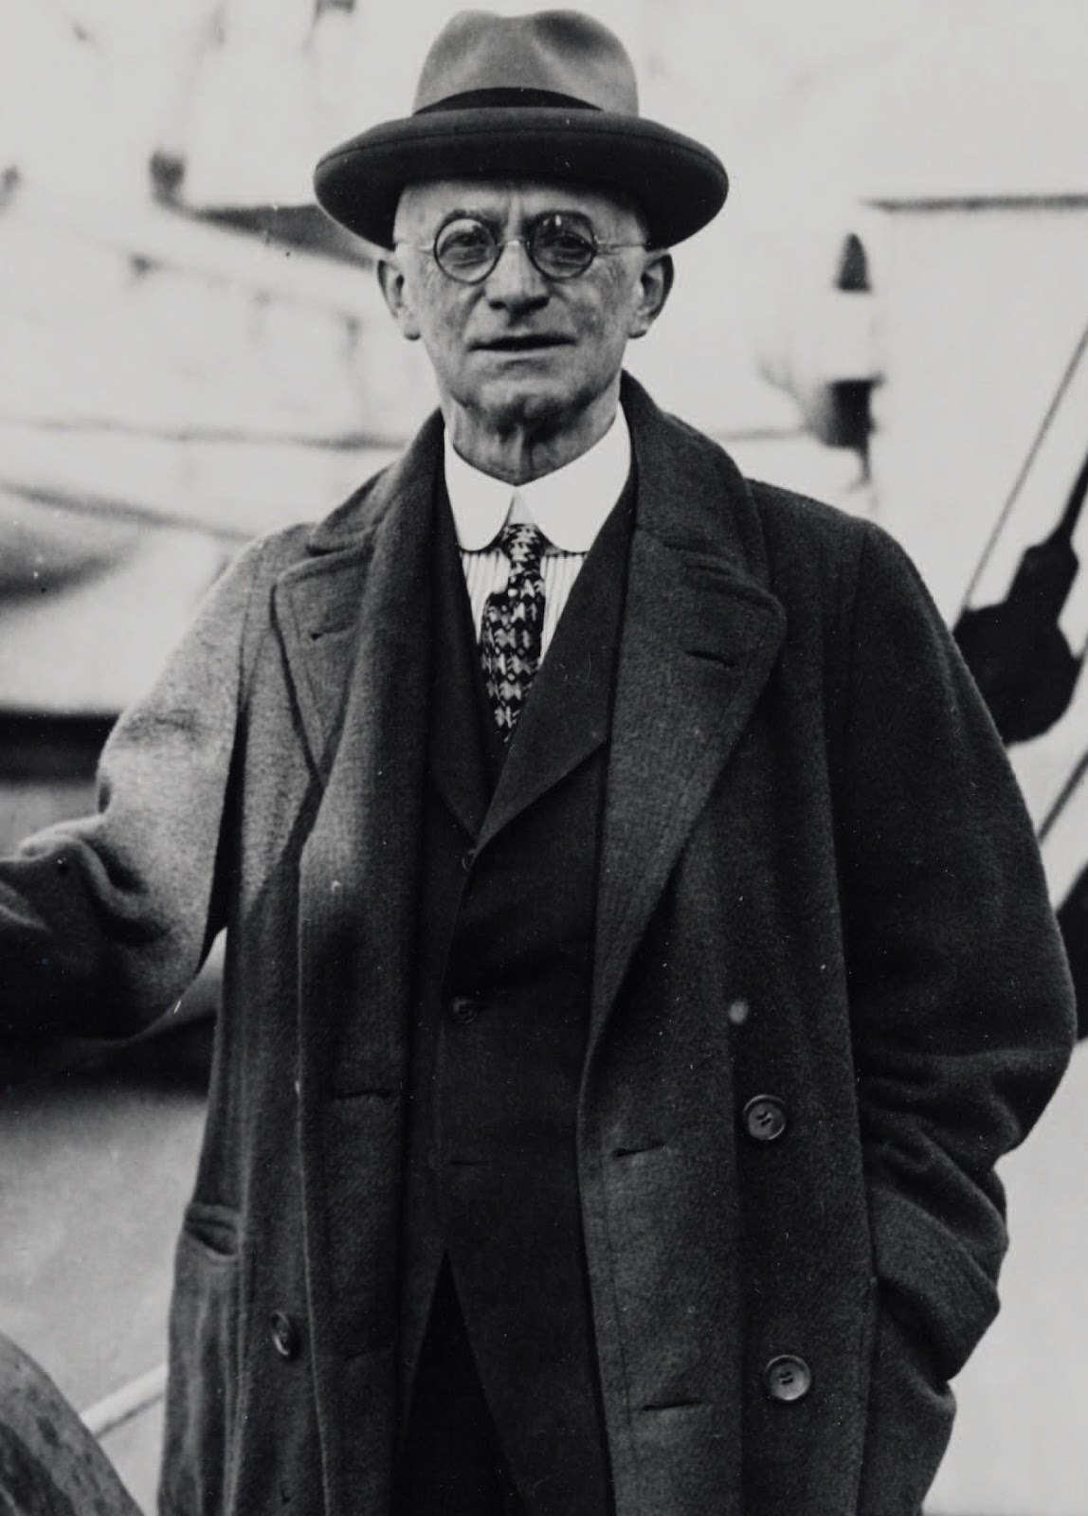
The Studio system Ayisha
Thomas Edison , the inventor of the lightbulb had a monopoly over the production of films because he owned the patent for the movie camera and this put a stranglehold on the industry.
Due to Edison's restrictions on films ,some filmmakers moved to Hollywood , California to get away from Edison's studio that was in West Orange, New Jersey
This moved marked the start of the studio system that would last for the next few decades and the studios adopted many of the common features that became hallmarks of the next few decades.
Thomas Edison
George Eastman
Notes:
Edison put a stranglehold on the industry because he would not allow for any innovation and as a result , most independent filmmakers moved to Hollwood
The studios owned everything to do with the filmmaking process which meant that the studios could decide what films got made and this ,once again , put a stranglehold on the industry

Slide 3
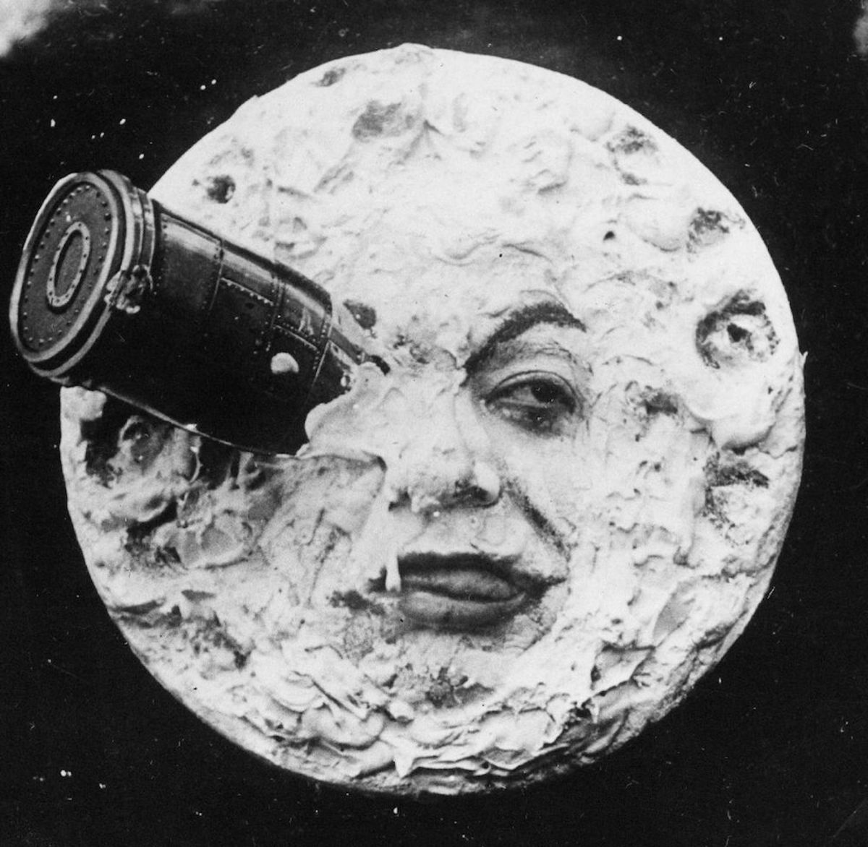
Movies of the Decade
A notable movie of the time period is 'a trip to the moon'(1902) directed by Georges Méliès,. This is a move where a group of French people are shot out a rocket to the moon and then fight off a group of moon men. What's notable about this movie is how unique the story and setting would have been to audience with how it for the most part established the concept of science fiction in movies. It is still regarded well today with it having a score of 8.2/10

Slide 4
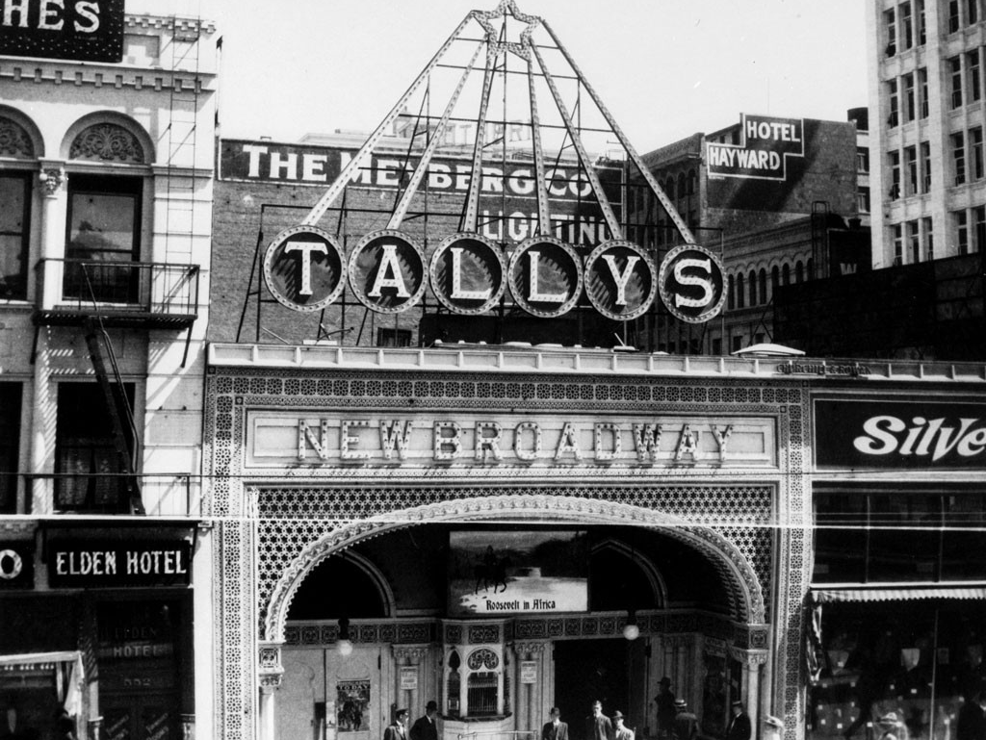
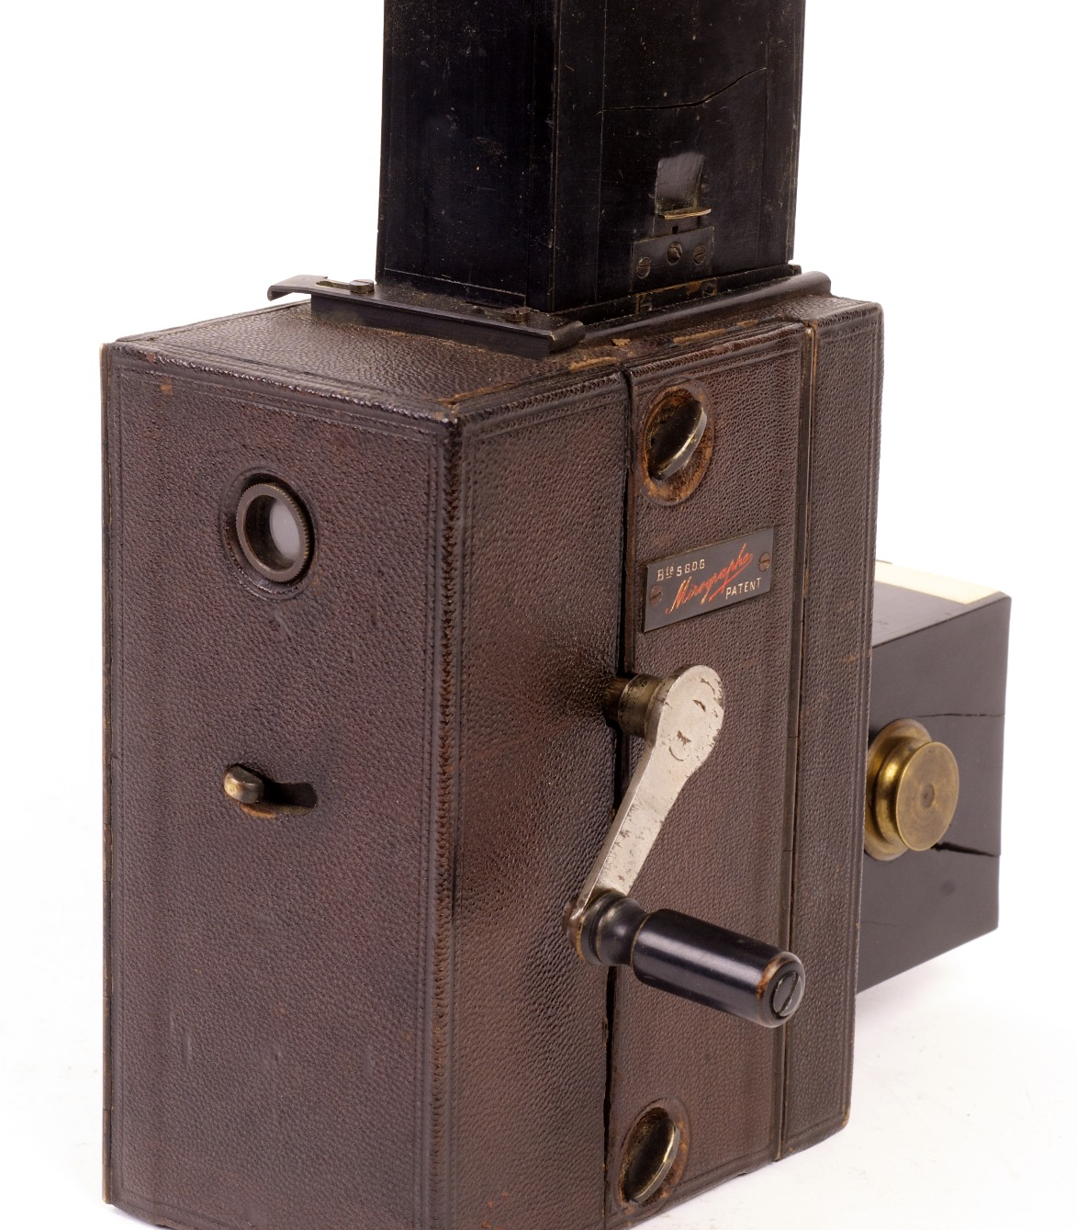
Technology
Goudeau & Co. Invent the Mirograph Camera in France, 1900 it is a 21 mm amateur format that allowed more people to go out and create films. In April 2nd, 1902, Thomas Tally opens the first permanent movie theatre, 'Tally's Electric Theatre'.

Slide 5
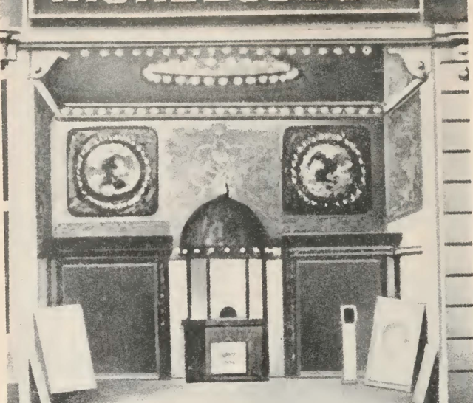
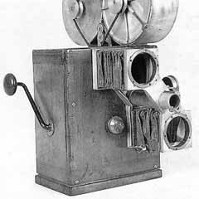
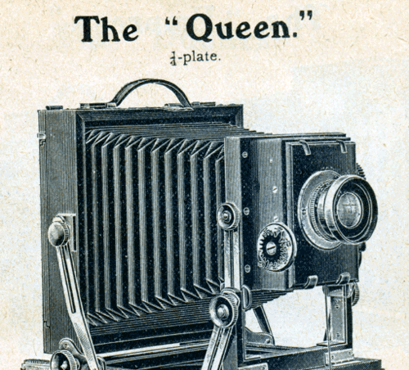
Camera's & Theatre's
June 19th, 1905, First Nickelodeon is opened by Harry Davis in Pittsburg, Pennsylvania. Their popularity grew immensely. There was no standard camera in the film industry with a lot of amateur camera formats being made which made the quality of films vary a lot from film to film.

Slide 6
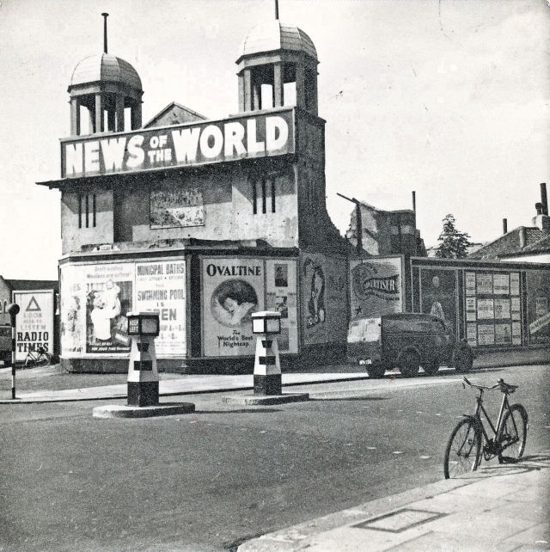
Innovations of the 1900's
The 1900's where when movies first began to receive mainstream cultural significance with the first cinema being opened in 1905. Allowing for the media of cinema to reach a wide and significant audience and eventually allowing for the technology and level of production to grow with the audience.

