Slide 1
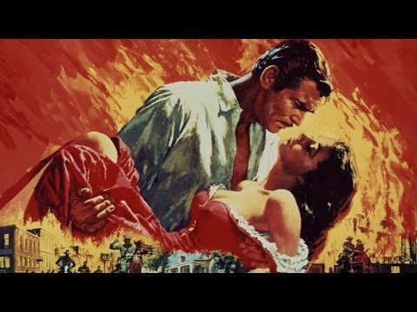
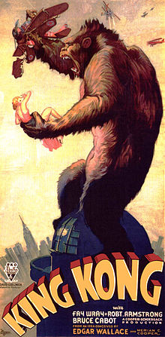
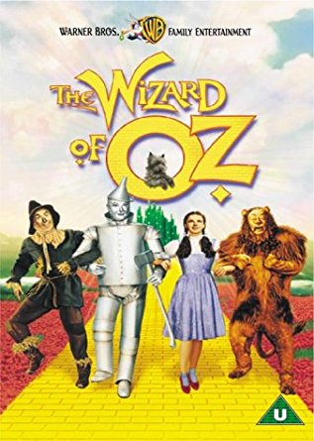
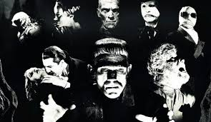
1930s Films

Slide 2
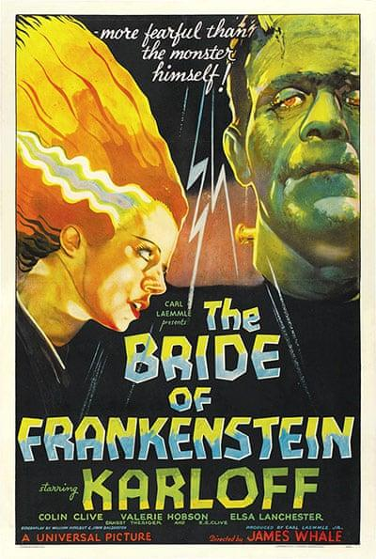
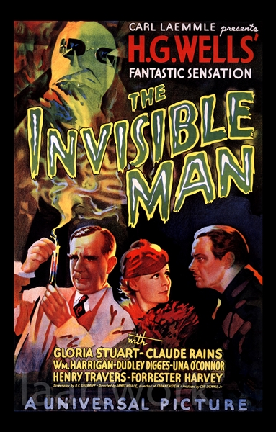
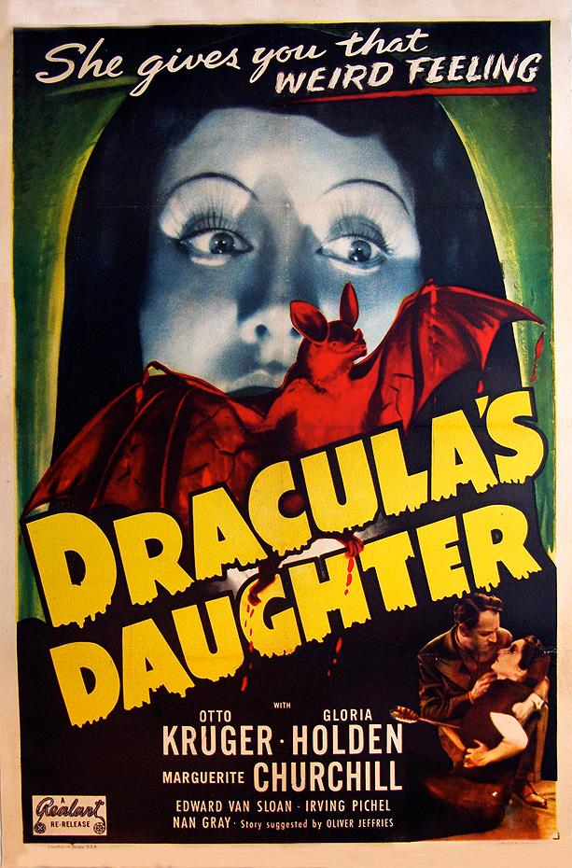
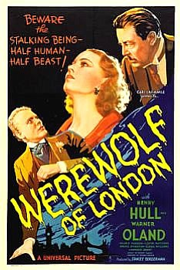
The true cinematic universe
The start of true horror in Hollywood

Slide 3
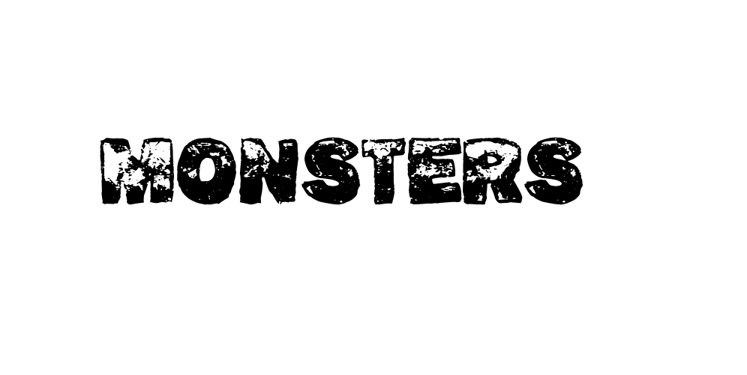
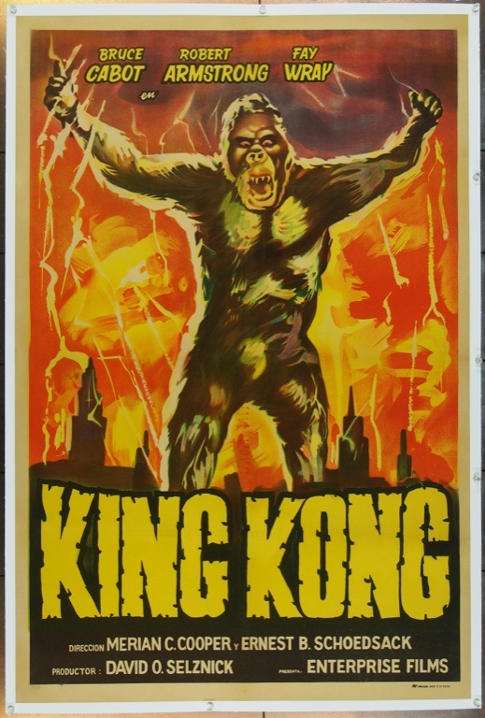
Apart from Universal Studios there was major popularity for more monster movies and to add competition other studios joint in.
The most famous movie from this era of film what impacted culture most was King Kong 1933 what became critically acclaimed in film for its use of stop motion and score while using matte painting, rear projection, miniatures all considered ahead of its time. It is included 7 lists of the Film Institutes and is 43 on the top 100 films. However it had a second release in the 1938 and had scenes cut as it was released before the pre-code era. It would have a sequel called the son of Kong released in the same year but did not reach the same heights.

Slide 4
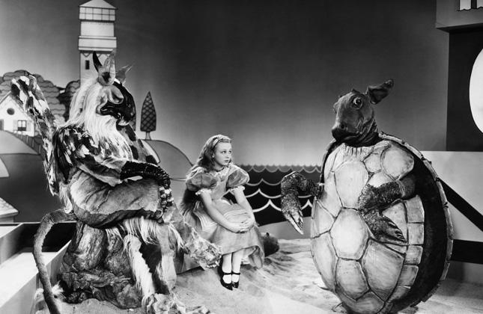
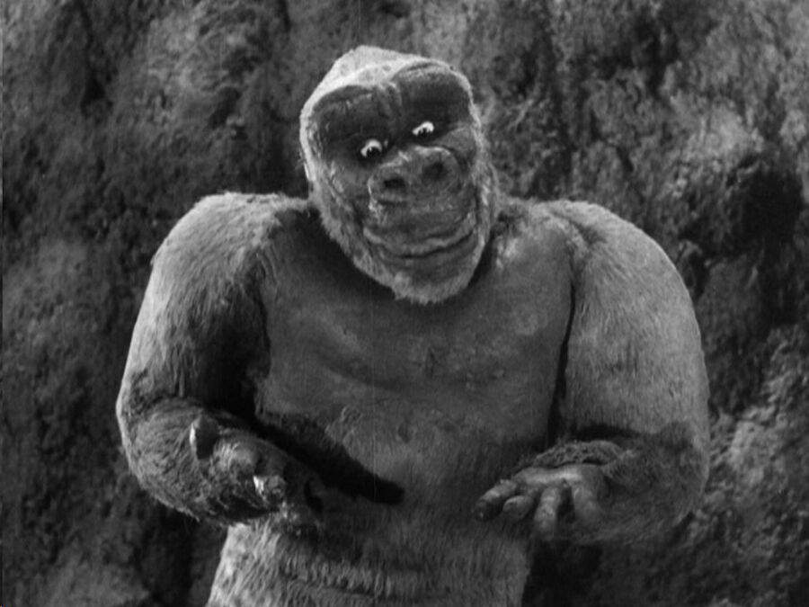
Remakes: .Alice in Wonderland
.Cleopatra
.Prisoner of Zenda
Sequels became popular for the monster movies as they were successful at the time and were big money makers at the box office while still getting positive reviews from critics. Son of Kong is a great example of this as this sequel was released only 9 months after the original movie.
Sequels: .Bride of Frankenstein
.Dracula’s Daughter
.Son of Frankenstein

Slide 5
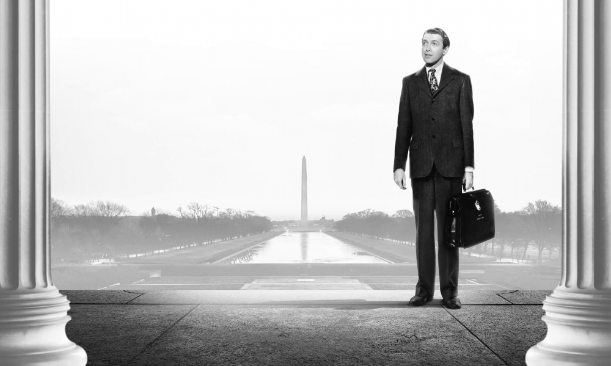
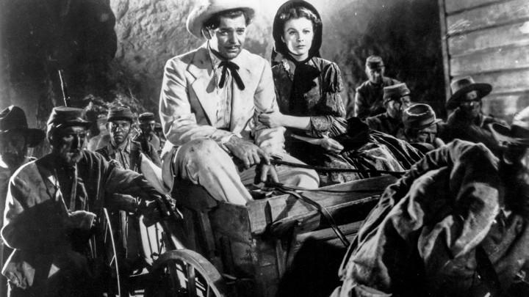
Gone with the wind
“The result is a film which is a major event in the history of the industry but only a minor achievement in motion-picture art.” Franz Hoellering, reviewer for The Nation
The wizard of Oz
Harrison's Reports wrote, "Even though some persons are not interested in pictures of this type, it is possible that they will be eager to see this picture just for its technical treatment. The performances are good, and the incidental music is of considerable aid. Pictures of this caliber bring credit to the industry."
Mr Smith goes to Washington
“This is classic Capricorn” Don Druker, Chicago Reader

Slide 6
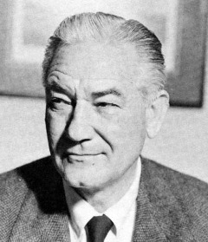
Quote on Victor Fleming
‘Who directed Gone with the Wind?” and nobody knows; you give them a second clue – it’s the same guy who directed The Wizard of Oz – and they say Mervyn LeRoy. Victor Fleming was either a wonderful director or the luckiest son of a b**ch in the world.” – Joseph L. Mankiewicz
Norman Z Mcleod reviews on his film A Gift.
It's A Gift (1934) is often cited as W. C. Fields' best and funniest picture - it is undoubtedly one of the greatest, classic comedies ever made,
W.C. Fields in his prime. If not his best, not far from it.

Slide 7
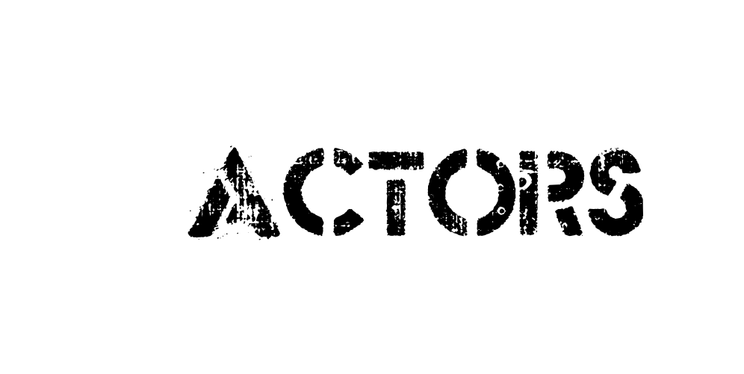
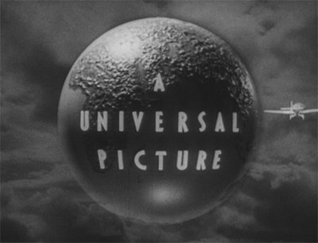
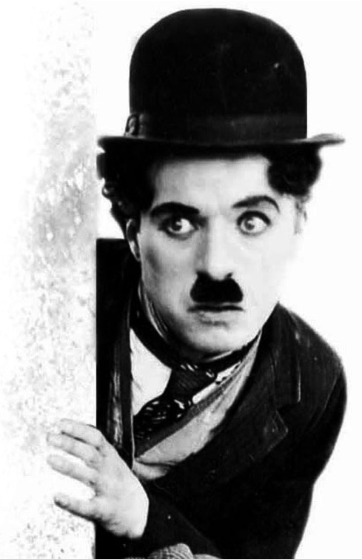
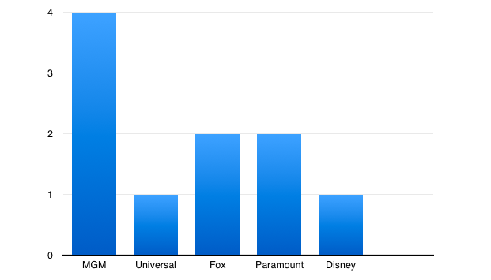
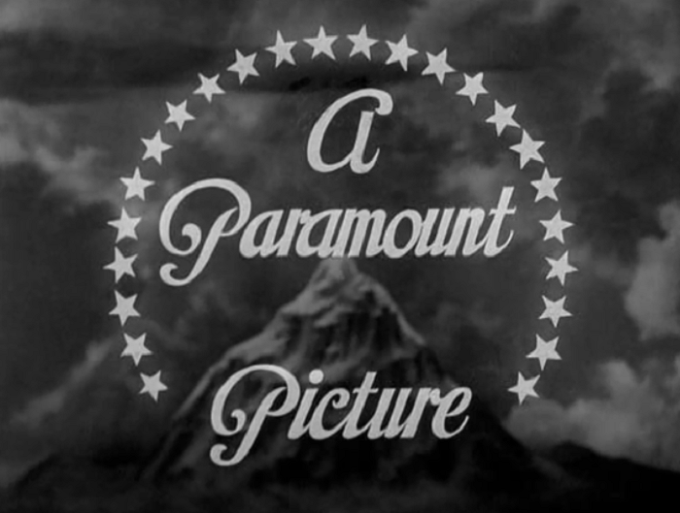
/
The most well known studios at the time were Universal Picture, Paramount Picture, MGM, Fox Film and Warner Bros.
Actors of the time Boris Laguf(Frankenstein), Claudette Colbert(Cleopatra) and most famously Charlie Chaplin who was apart of the silent era of film.

